Slide 1
Film Project
Romance film
Wong Ming Choi, Tom (17664365)
Ng Ka Hei, Tim (17664799)
Chan Tsz Ling, Elaine (17670659)
Lam Chun Man, Billy (17669855)
Chau Chun Hin, Abe (17669502)
Chan Nattapong, Alpha (17677769)
GECV4106 Film Appreciation
(Section 52)

Slide 2
Introduction (Overview)
We will have a romantic association when we are watching a romantic movie
-> certain elements affect us
Understand the storyline and plots of those romantic movies
-> observe the attraction of romantic movies
Have a study and compare with pre-1960s and post-1960s romance films
-> Pre-1960s: Casablanca(1942), Roman Holiday(1953)
-> Post-1960s: Titanic(1997), About Time(2013)

Slide 3
What is Romance Film?
Romance films are love stories
It is about passion, emotion, romantic, & affectionate of the main characters
Most romantic films do not have fairy-tale, wistful-thinking stories or happy endings
Often explore a variety of theme within love
-> bring a fantasies and evoke strong emotions for viewers
https://www.filmsite.org/romancefilms.html

Slide 4
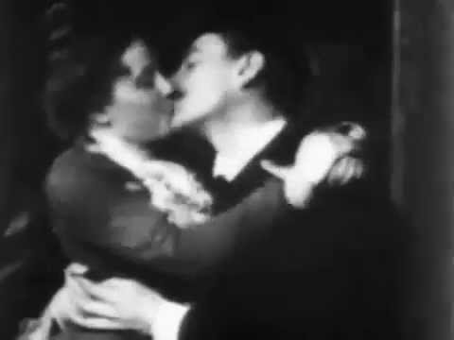
History
The Earliest Romance Films
Thomas Edison's early, 20-second long The May Irwin Kiss (1896) (aka The Kiss, or The Irwin-Rice Kiss)

Slide 5
The earliest available romance film mainly focuses on silence interaction between couples. However, even then, some were still considered offensive.
It was not until the 1930s where we had our first Romantic comedies.
Moving on 10 years later, audience were attracted to a new style of romance, destructive romance, where characters in the movie were always in danger.
Around the same time, we also have romantic film featuring “killing for love”.
Later in the 60s, we actually got a “Romantic pairs”.
Over the next 40 years, film industry had explored different idea in romantic films, ghost romance, and homosexuality.
From the period of 1980s and onwards, modern Hollywood storm the romance genre with newer technologies which allows filmmaker to explore ideas that otherwise not possible with technologies before.

Slide 6
Narrative conventions
The meaning at the very basic form is what and how an audience understand what is happening in the film through visual or audio. It is not the same plot, as plot is just what’s happening on paper.
In some films, there is a narrator telling us what is happening at the start (Exposition).
  First Person
  Second Person
  Third Person
Most film will have the actor act, move, and behave in a way that the audience will understand the kind of person a character are.

Slide 7
Stylistics conventions
“Of or concerning style, especially literary style” - Oxford Dictionary, 2018
In Film, we can define this as:
Shooting Techniques
Dialogue
Color Contrast
Props
Clothes

Slide 8
Iconography
When we watch a movie in a certain genre, we expect to see certain elements.
E.g. When we watch the film about Western, we will expect to saw desert, horses and cowboy.
Therefore:
Sexual scenes
Complicated relationship
Relationship crisis
Marriage
Different in social status
An object pass through the hold film
Sacrifice initiated by love
Notes:
https://www.filminquiry.com/analyse-movies-iconography/

Slide 9
Classics (Pre-1960s)

Slide 10
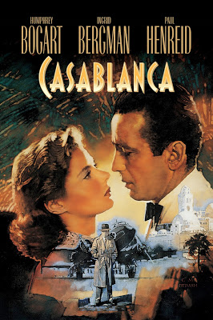
Film 1 (Casablanca)(1942)
In the early stages of WWII, Rick runs a bar in Casablanca. Due to the good relationship with local government, his bar has become a kind of haven for refugees to obtain visa letters that can help them to leave. One day, Ilsa, his lover, and her husband show up to his bar to obtain visa letters. At that time, Rick faces a tough challenge to do a painful decision. Finally, Rick let them go because he loves Ilsa.

Slide 11
Narrative conventions
Flashback
Memory of love story between Rick and Ilsa in Paris.
The relationship between Rick and Ilsa. (Explanation)
Notes:
https://gointothestory.blcklst.com/studies-in-flashbacks-casablanca-7e154431d19c

Slide 12
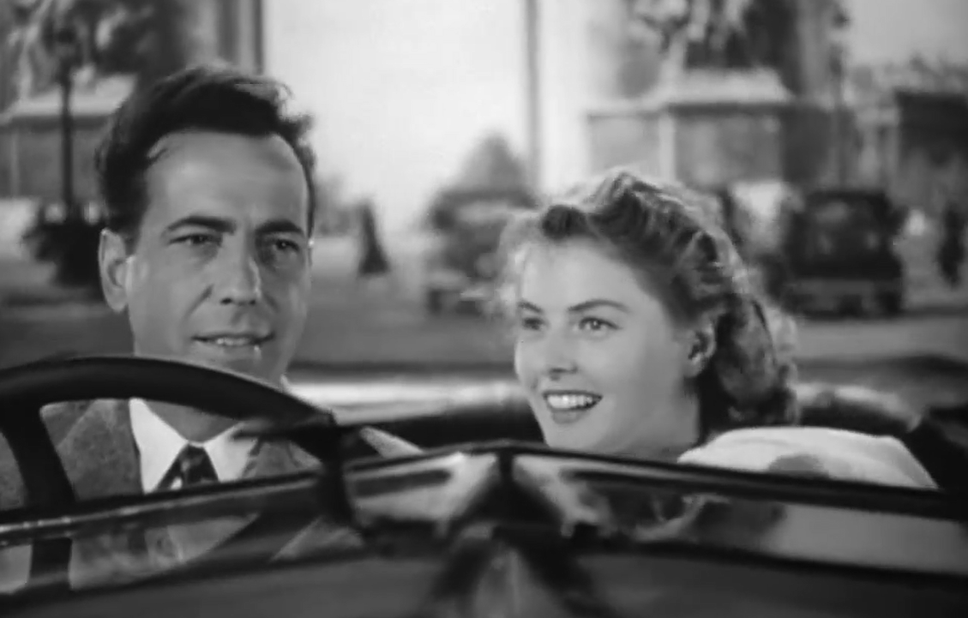
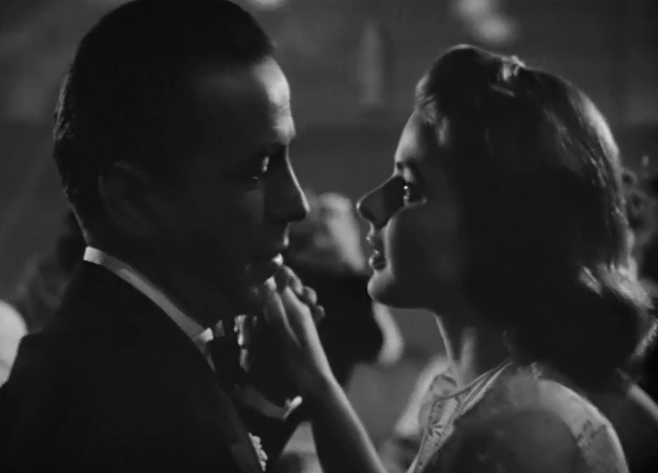
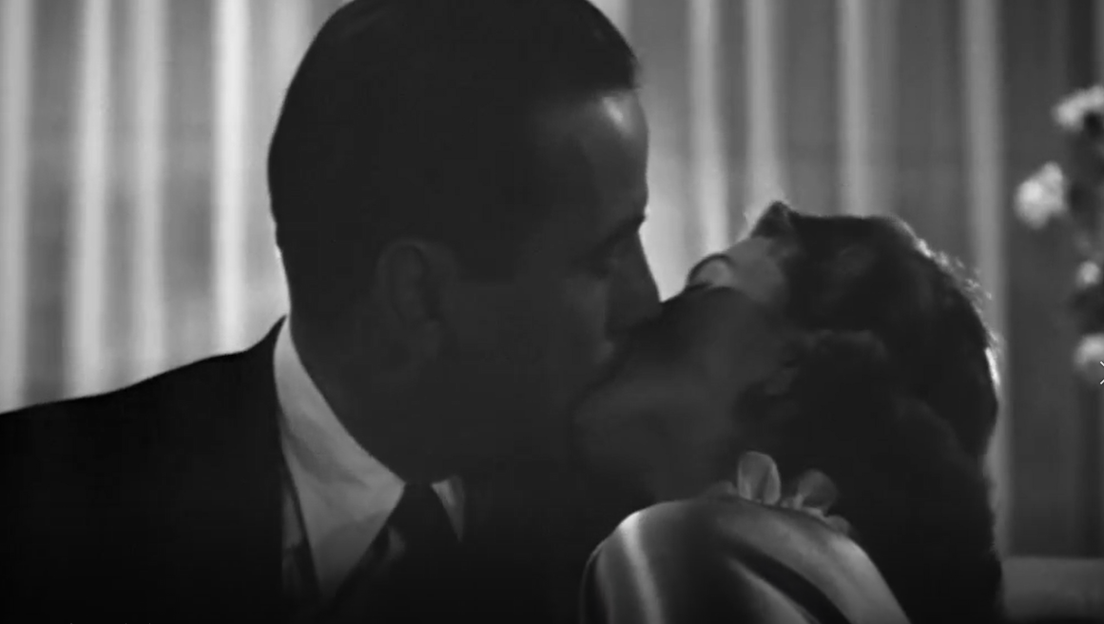
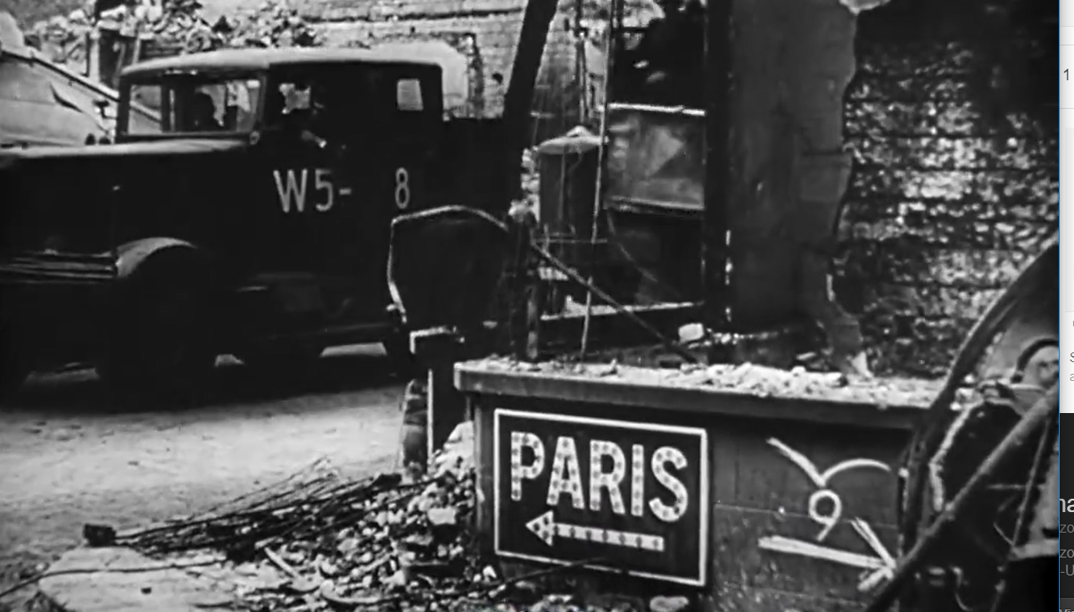
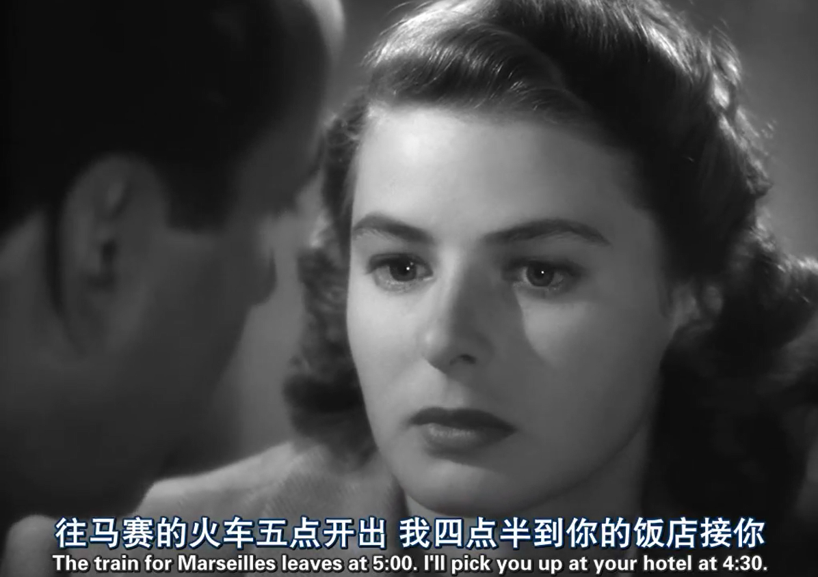
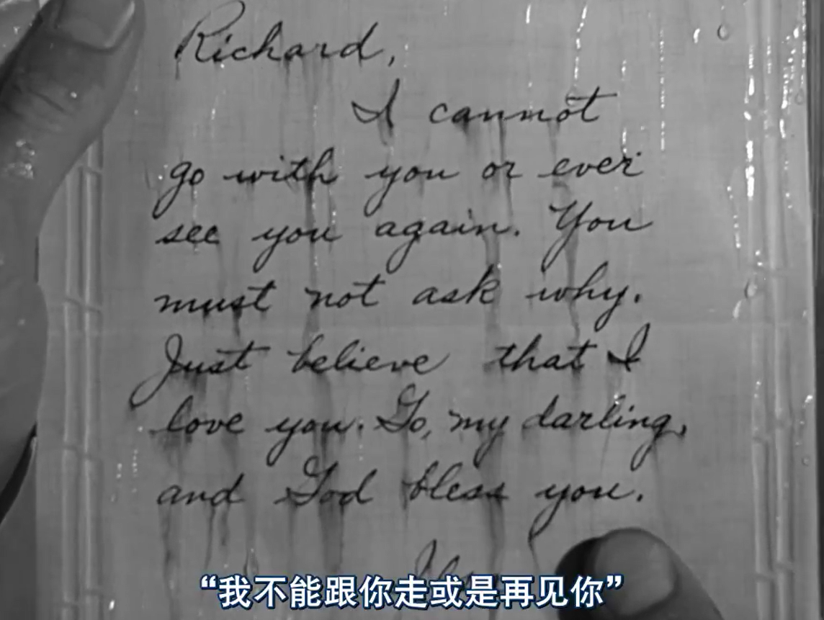
Stylistics conventions
Montage (The love between Rick and Ilsa in Paris)
Driving in Arc de Triomphe> Ball >First kissing scene > Germans will enter the Paris soon > Rick and Ilsa plan to meet with train station> Ilsa does not show up
Notes:
https://gointothestory.blcklst.com/studies-in-flashbacks-casablanca-7e154431d19c

Slide 13
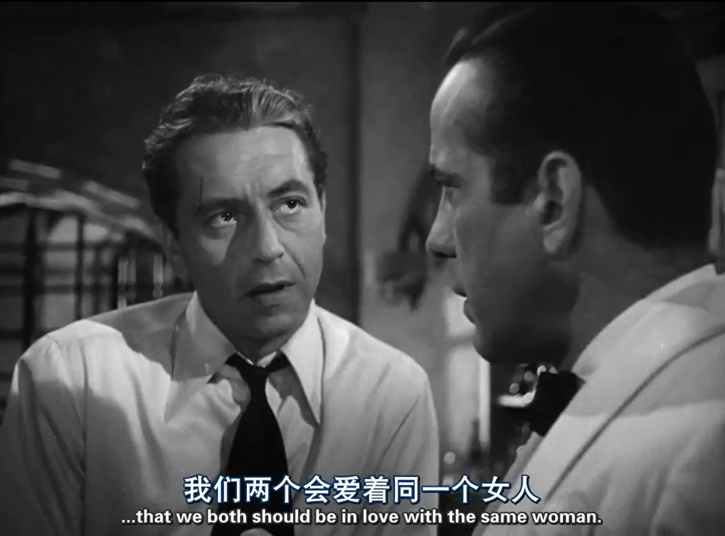
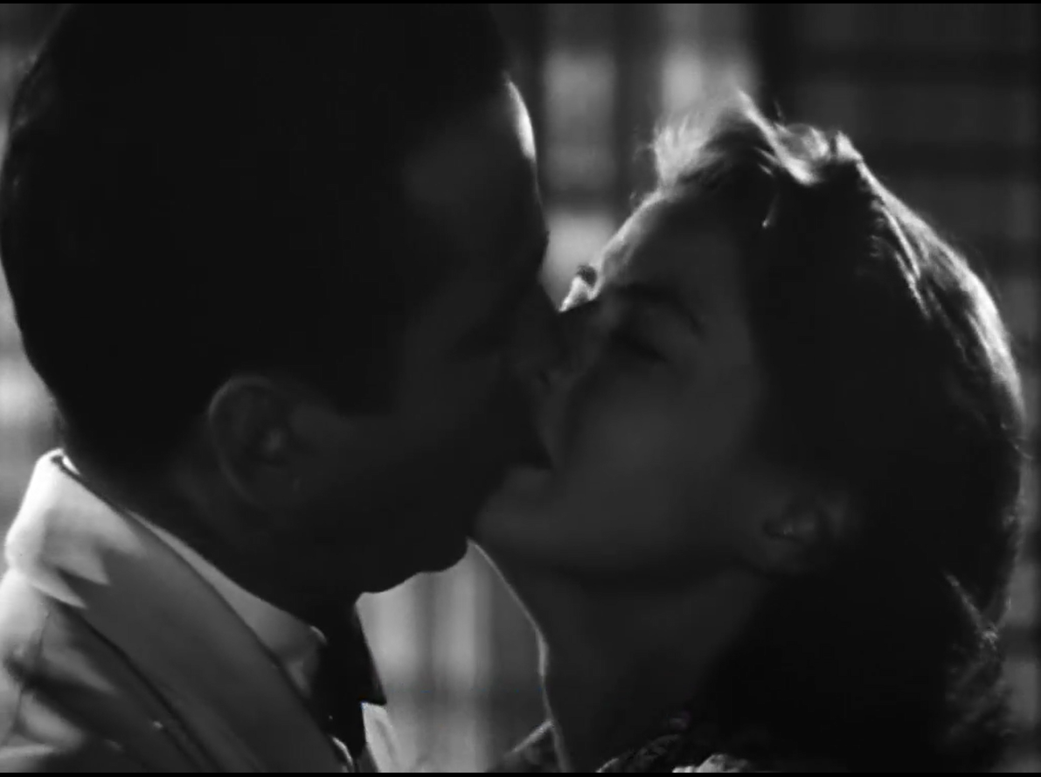
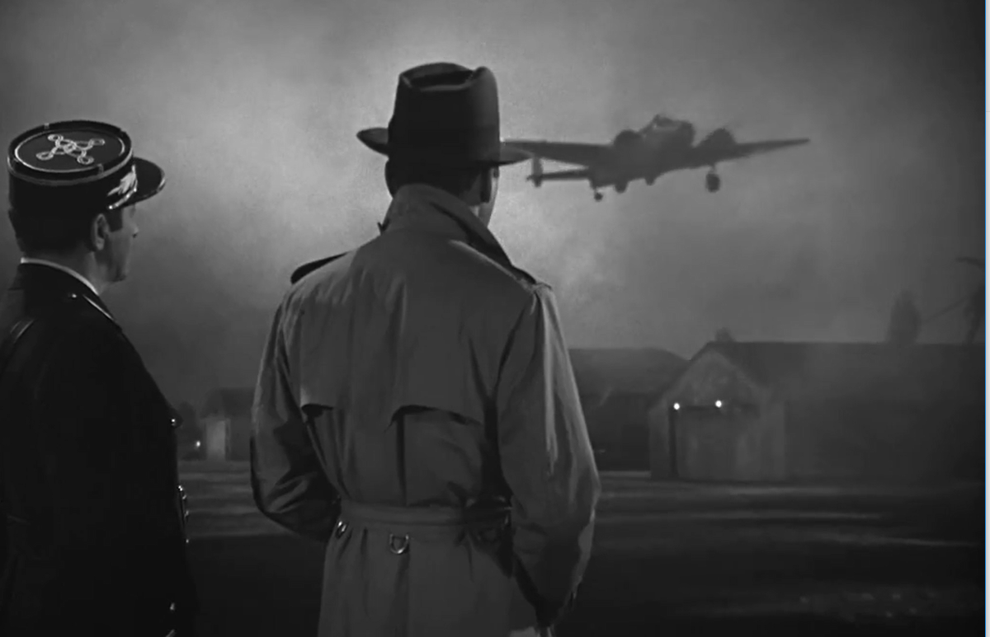
Iconography
Complicated relationship
The love triangle relationship between Rick,
Ilsa and Laszlo
Pardon and Sacrifice from Rick
Rick pardons Ilsa.
Rick gives up the chance to leave and gives the chance to Ilsa and Laszlo.
Kiss scene

Slide 14
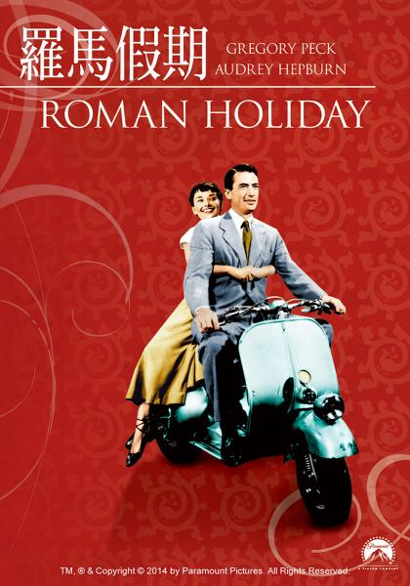
Film 2 (Roman Holiday)(1953)
A princess from an unnamed fictional city Ann is visiting Rome, Italy. A city that is of cultural significance.
Tired of being a princess, she sneaks out the palace she was staying in, and have fun.
She was later picked up by Joe, an American journalist, who was worried she is going to be pick up by local police.
Joe later found out she was a princess, and attempt to get close to her in order to write story for the paper he works for.

Slide 15
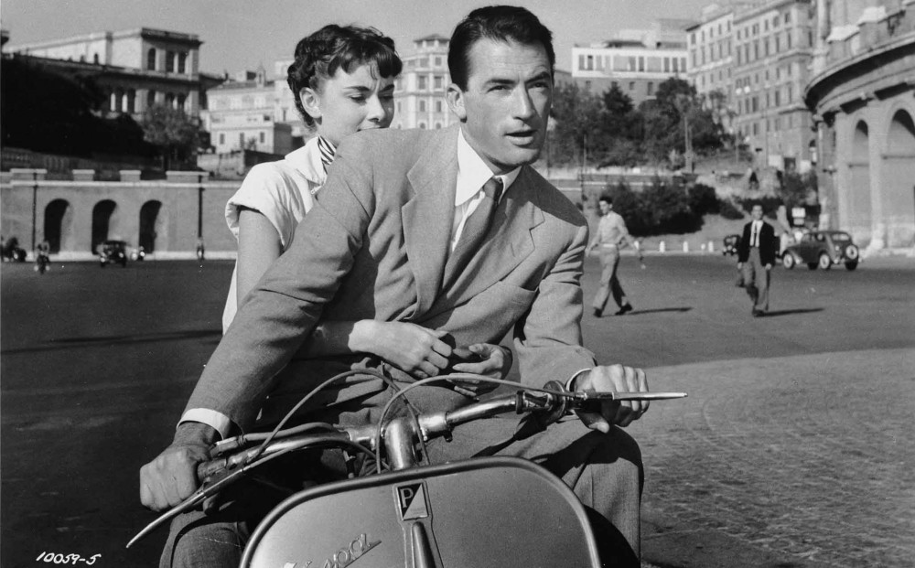
After series of adventures touring around Rome, and even getting chased by the police. They shared a kiss..
But, at the end, their love did not prospered, as Ann remembers and understands her royal responsibilities to the throne, decide to resume her duty in Rome.
However, in the final scene, Joe was seen in the press conference where Ann were also at. Understanding that their lives were ultimately different from one and other, they both gestured their farewell and walked different path.

Slide 16
Narrative conventions
Music
  The movie use of music to indicate developments in relationship between Joe and Ann.
The location of the film
  The film was done entirely in Rome, one of the more cultural significant city in Europe. Giving the audience a romantic feel when they see the iconic landmarks.

Slide 17
Stylistic convention
Final scene.
  It was shown that even when Joe can’t be with Ann, the scene keeps cutting back and forth to the direction where Ann walked away to show he misses her.
Minimal cuts.
  How much cuts during dialogues so the audience can better immerse into Joe and Ann’s love story, even the chase scene toward the end of the movie.

Slide 18
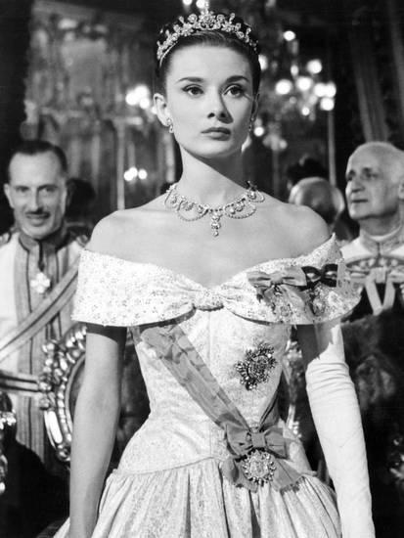
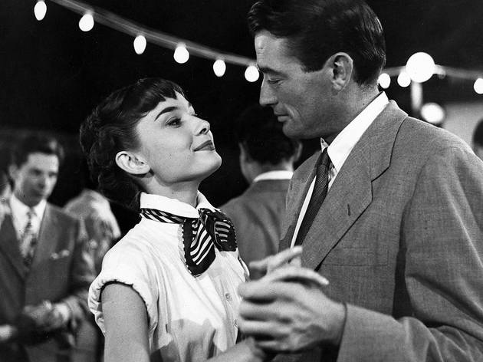
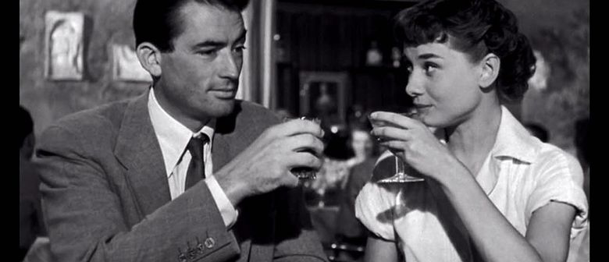
Iconography
Romantic settings
The kiss
The conflict
  The tension
A pair
Suit & Tie for male
Social status
A love developing

Slide 19
Modern (Post-1960s)

Slide 20
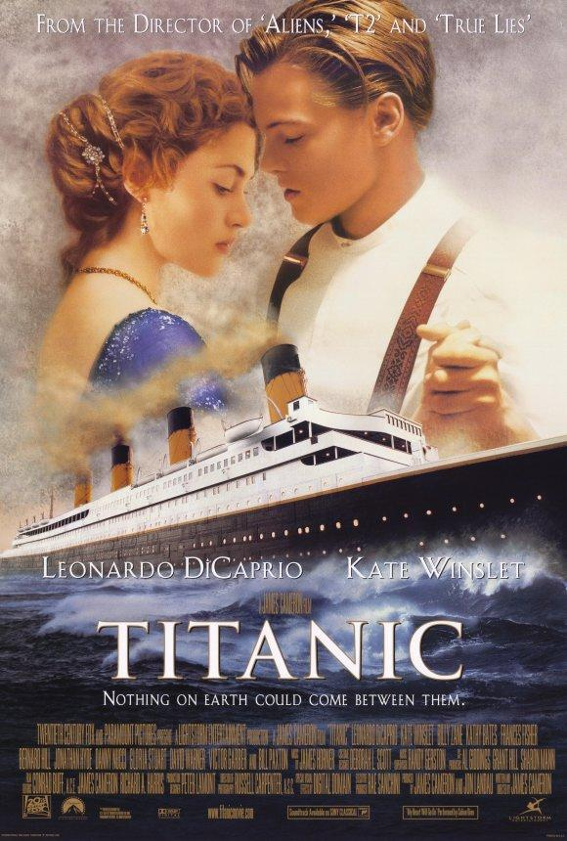
Film 3 (Titanic)(1997)
Film begins with Rose seeing the items from the sunken titanic, recalling her memories on the titanic.
Storyline begins here - Rose was forced into an engagement with Cal, a rich noble.
Rose attempts to suicide, meets Jack, and saves her.
Rose models for Jack’s paintings, and even slept a night together.

Slide 21
Cal despises Jack for his social class and forbids Rose from seeing him.
Rose breaks up with Jack, but realizes she’s fully in love with him.
Tensions between the 3 continue to rise despite the oncoming danger.
Rose resolves that she will stick
As the Titanic starts to sink, Jack sacrifices his life for Rose’s safety, and embraces their time together. Rose even took up his last name, Dawson.
In memory of Jack, Rose threws the treasured memories back into the ocean.
An alternative reality ending scene saw Jack and Rose dancing and living a happy ending on the titanic.

Slide 22
Stylistics conventions
Start from the memories
Shot from the ocean
Contrast of camera filming

Slide 23
Iconography
Complicated relationship
  Rose was doubting her relationship with her Fiance, Caledon. But later, it was Jack that gave her the happiness.
Different in social class
  Rose is from a noble family, while Jack is a lowerclassmen trying to go to America

Slide 24
An object pass through the hold film
  The necklace was given to Rose that were important throughout the film
Sacrifice
  Jack sacrifice himself so the plank that Rose was also on won’t sink into the sea because of their weight.

Slide 25
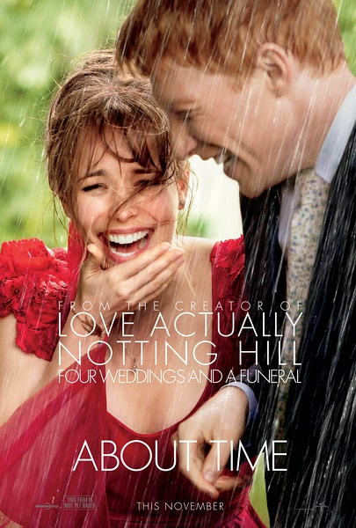
Film 4 (About time)(2013)
This is the love story about main actor (Tim) who have the time travel ability to changing history. However he do not have the ability to change the destiny of a person life and death. Tim aim to find girlfriend by using the special talent, this is his mothership.

Slide 26
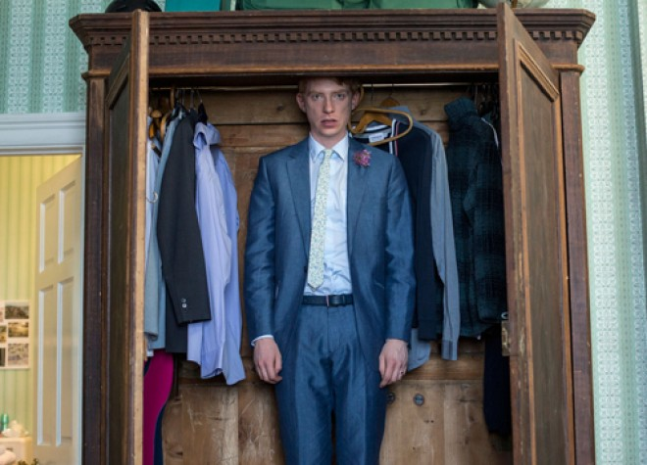
Narrative conventions
Sex scene
  Tim trying to give the best sexual experiences to Mary, so he uses his ability to continuously travel back in time.
Time traveling
  The use of time traveling by Tim to fix his mistakes was seen throughout the movie, especially his romantic relationship with Mary

Slide 27
Stylistics conventions
Repetition (Time-travel)
Tim travel in time for Family Mary and Charlotte and tim is trying to changing the history
The beginning corresponds with the ending
The first time Tim travel in time and the last Kiss between him and his father

Slide 28
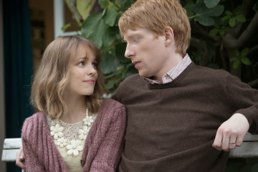
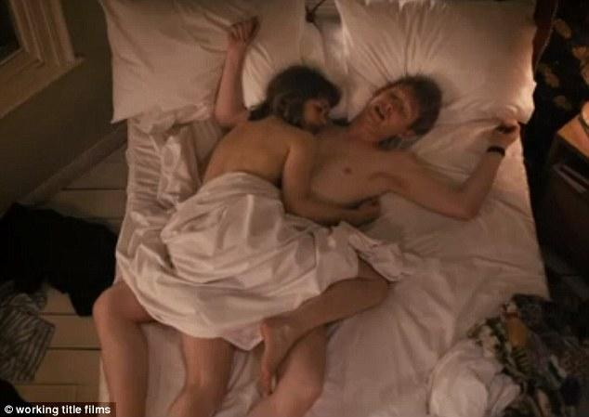
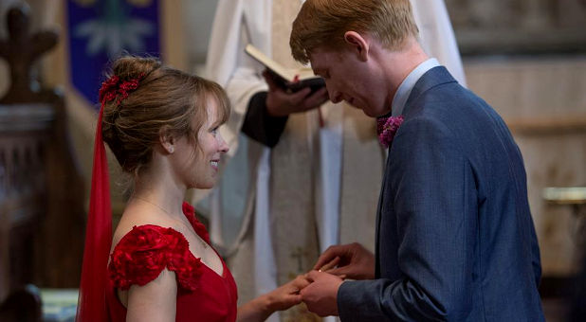
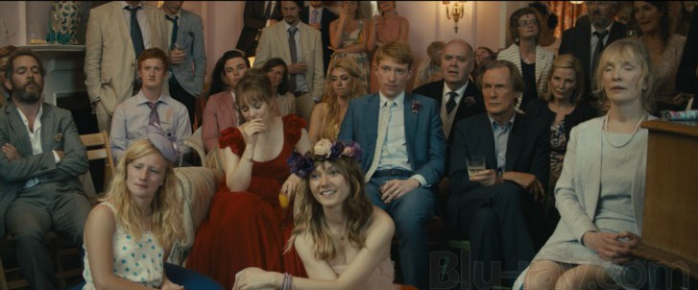
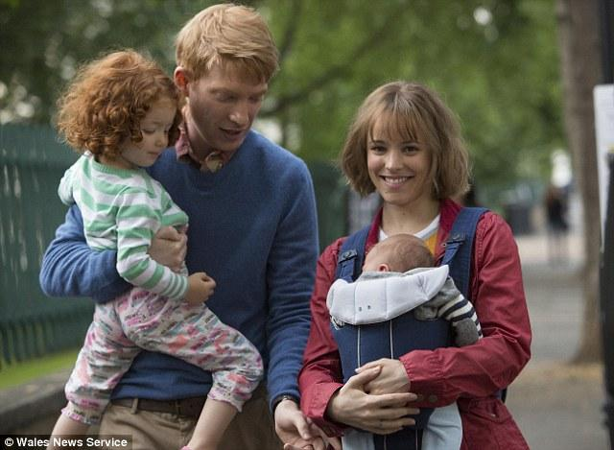
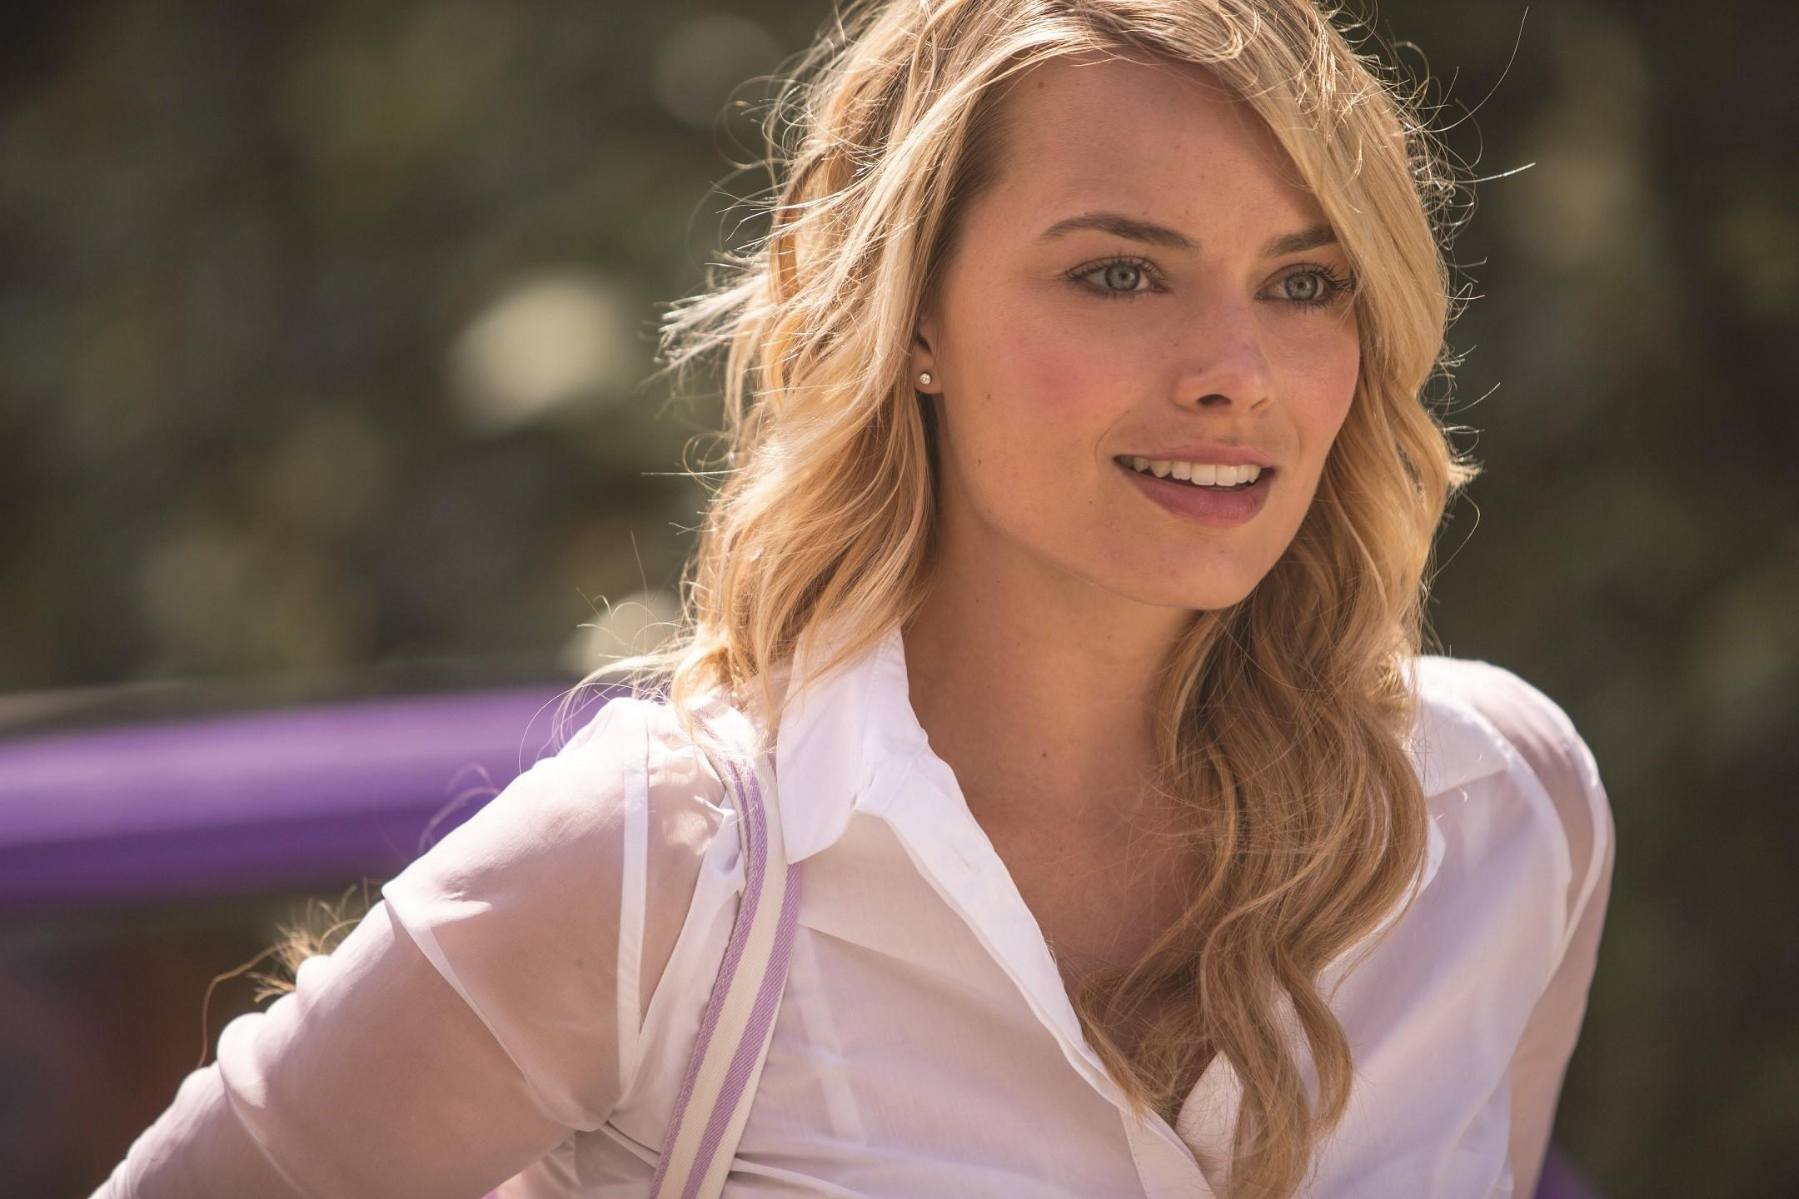
Iconography
Love triangle (Tim, Mary and Charlotte)
Mary and Tim Wedding
Family (Home)
Sexual scene and Kiss
Kids
Sacrifice (Time)

Slide 29
Conclusion
In conclusion, the romance genre had seen its fair share of changes since it invention in late 1700.
From its early restrictions on what could be shown; Even kissing on screen is considered inappropriate and offensive.
To later, it is common to kiss, hug and dance together.
  Examples, “Roman Holiday (1952)” & “Casablanca (1942)”
To eventually the modern romance, where the show of sexual activities, and even homosexuality is common among viewer of all age.
  Examples, “Titanic (1997)” & “About Time (2013)”

Slide 30
Reference
Myers, S. (2013, 3 5). Studies in Flashbacks: “Casablanca”. Retrieved from Medium: https://gointothestory.blcklst.com/studies-in-flashbacks-casablanca-7e154431d19c
Perez, K. (n.d.). Casablanca (1942). Retrieved from IMDb: https://www.imdb.com/title/tt0034583/?ref_=fn_al_tt_1
Preryra, A. (n.d.) Titanic (1997). Retrieved from IMDb: https://www.imdb.com/title/tt0120338/?ref_=nv_sr_1
Huggo (n.d.) Roman Holiday (1953). Retrieved from IMDb: https://www.imdb.com/title/tt0046250/?ref_=fn_al_tt_1
ROMANCE FILMS (2010). ROMANCE FILMS. Retrieved from https://www.filmsite.org/romancefilms.html
Universal Pictures. (2013). About Time (2013) - IMDB. Retrieved from imdb.com: https://www.imdb.com/title/tt2194499/
Stylistic | Definition of stylistic in English by Oxford Dictionaries. (n.d.). Retrieved from https://en.oxforddictionaries.com/definition/stylistic

