Slide 1

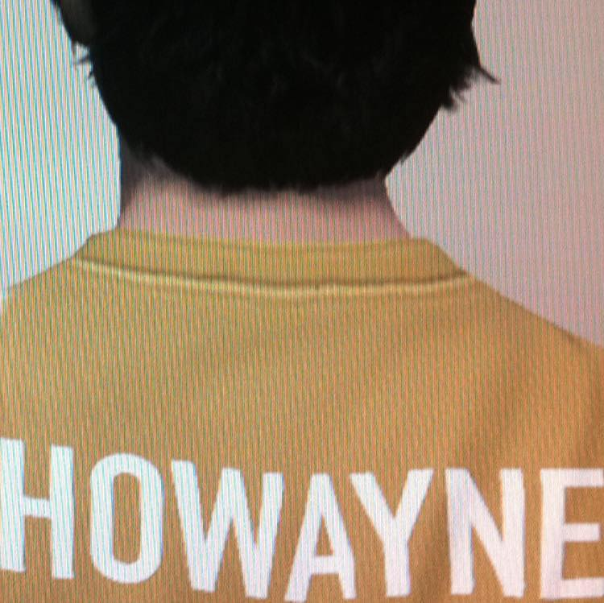
Wayne Ho- The Way Of Watching Football

Slide 2
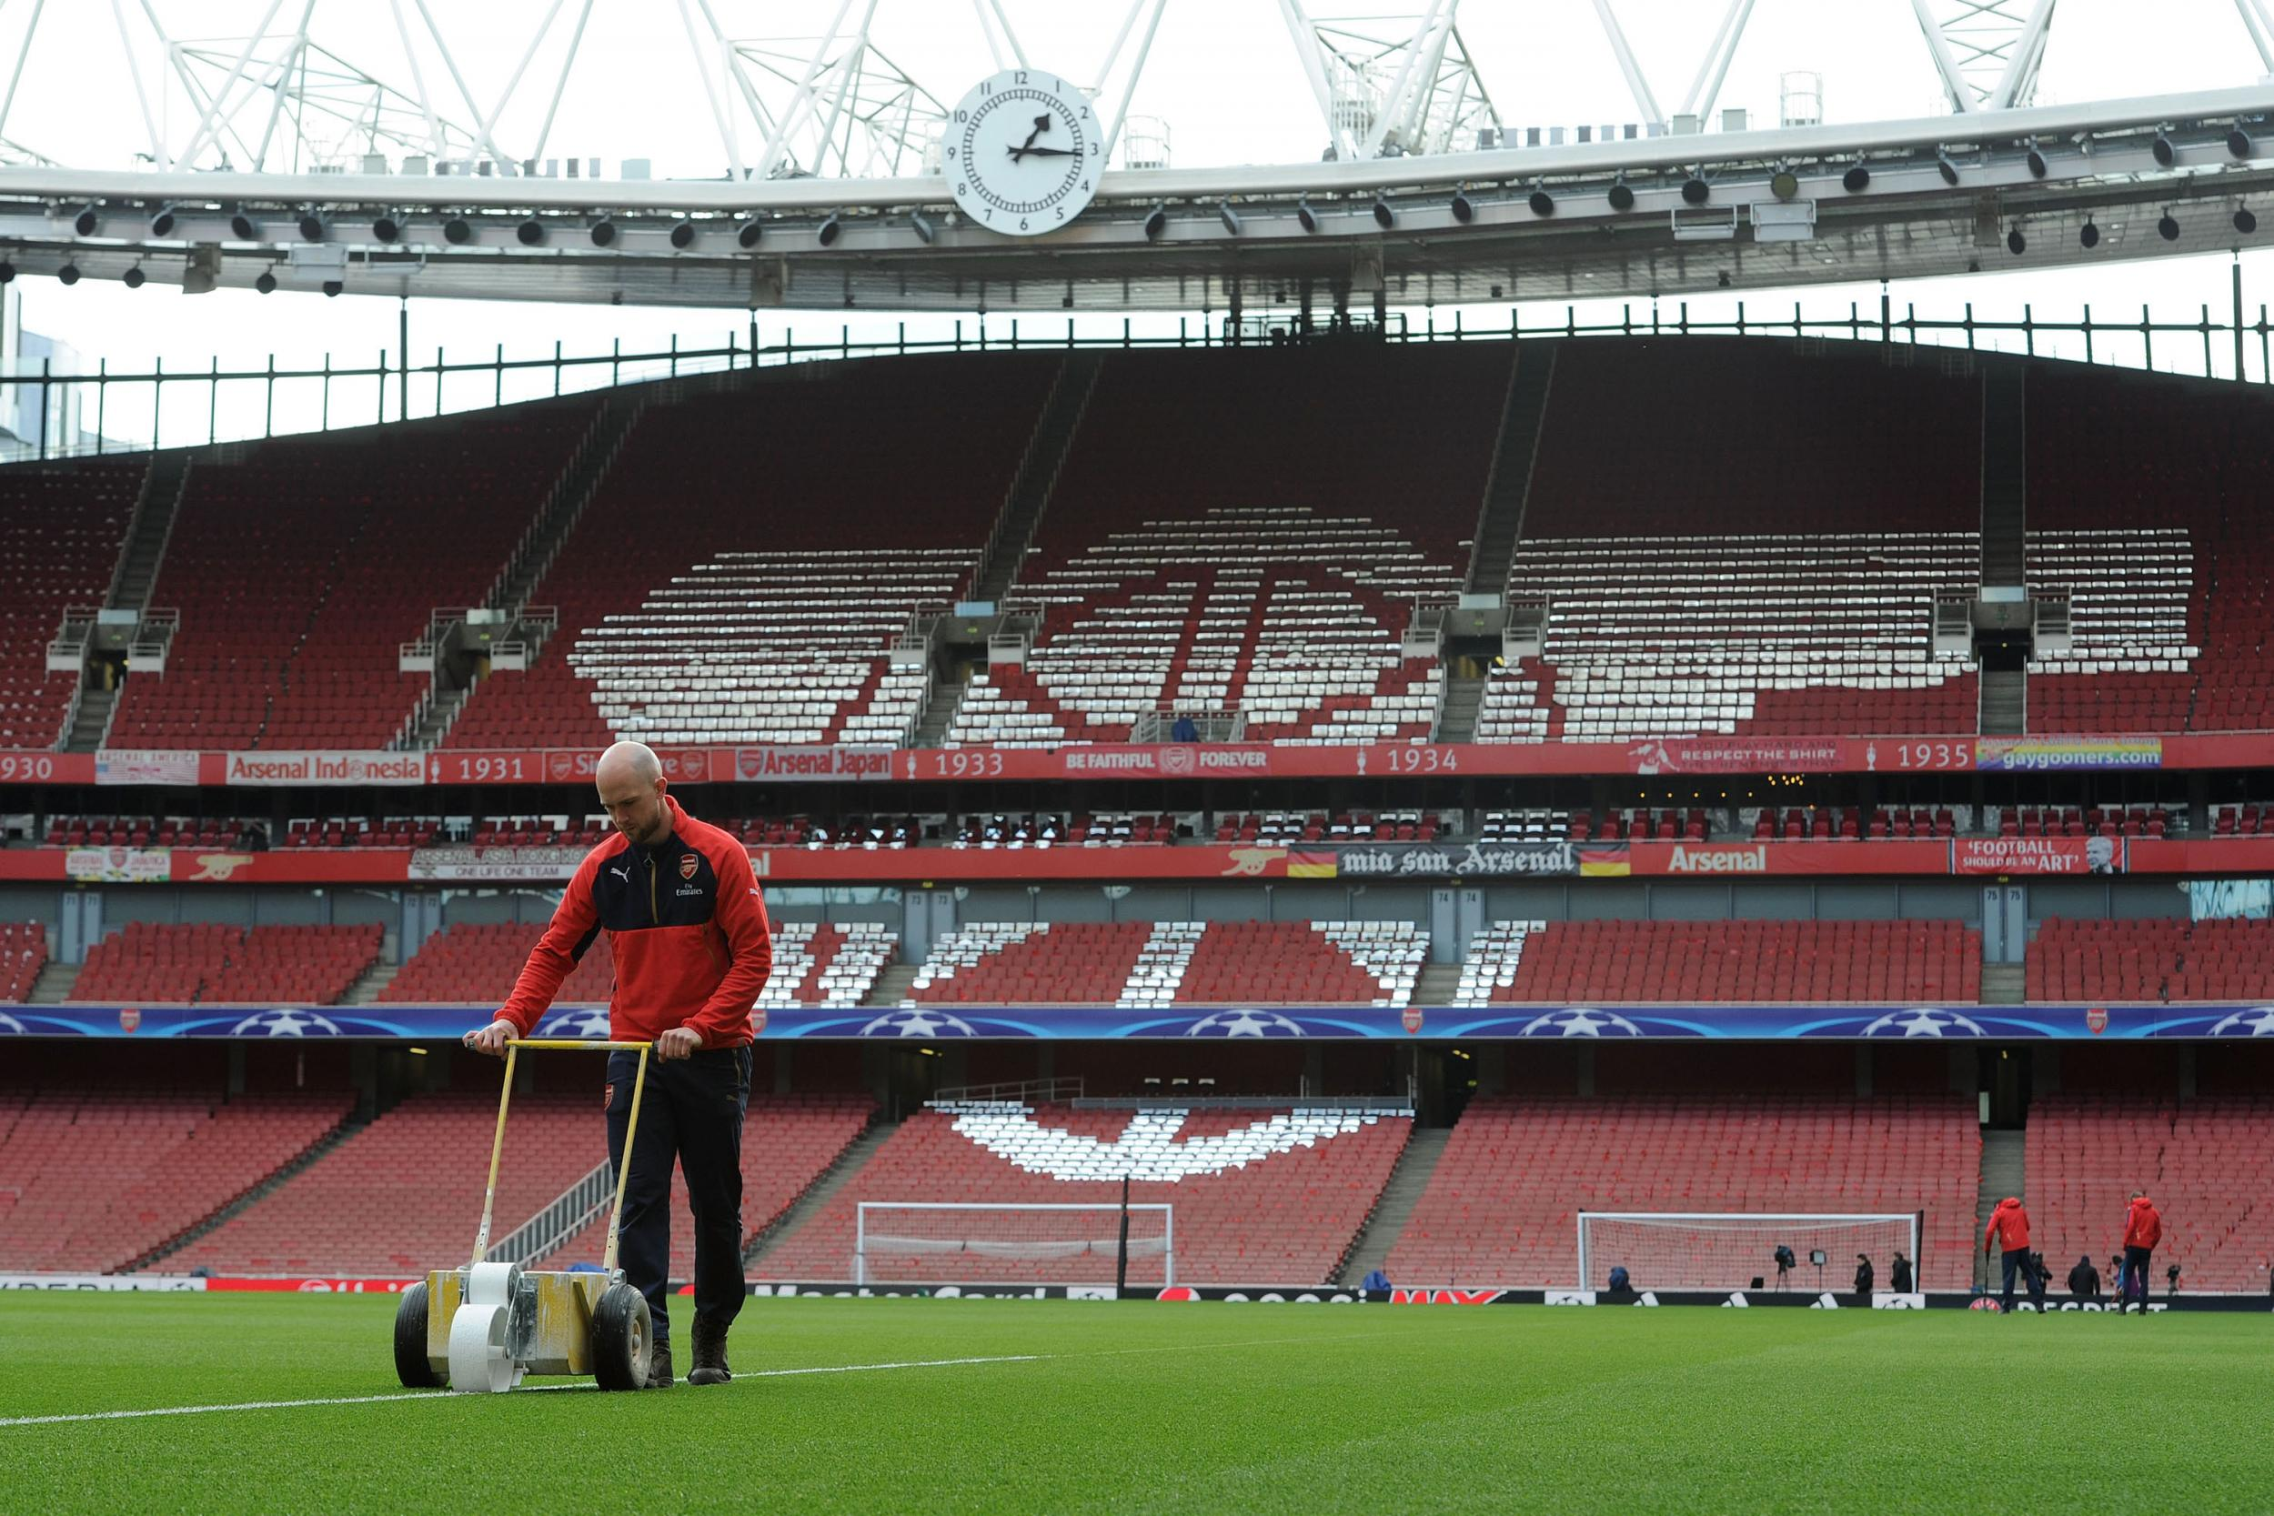
CONTENT
Research Design Stage Final output
Mapping MOOD Borad
Positioning Web Page
Suggestion

Slide 3

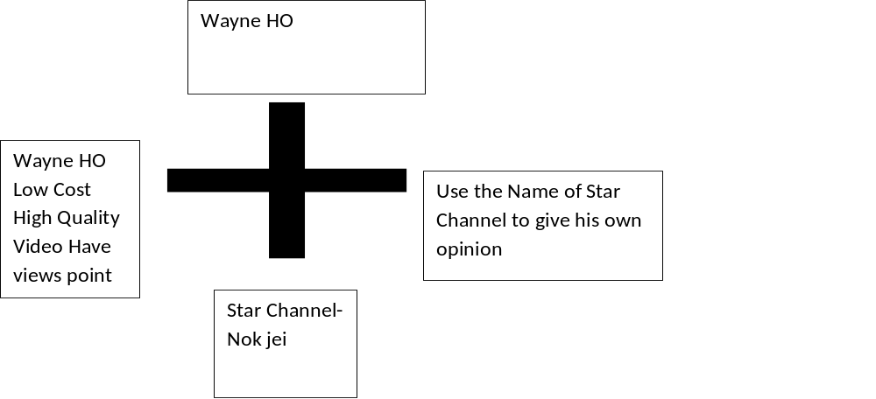

Slide 4
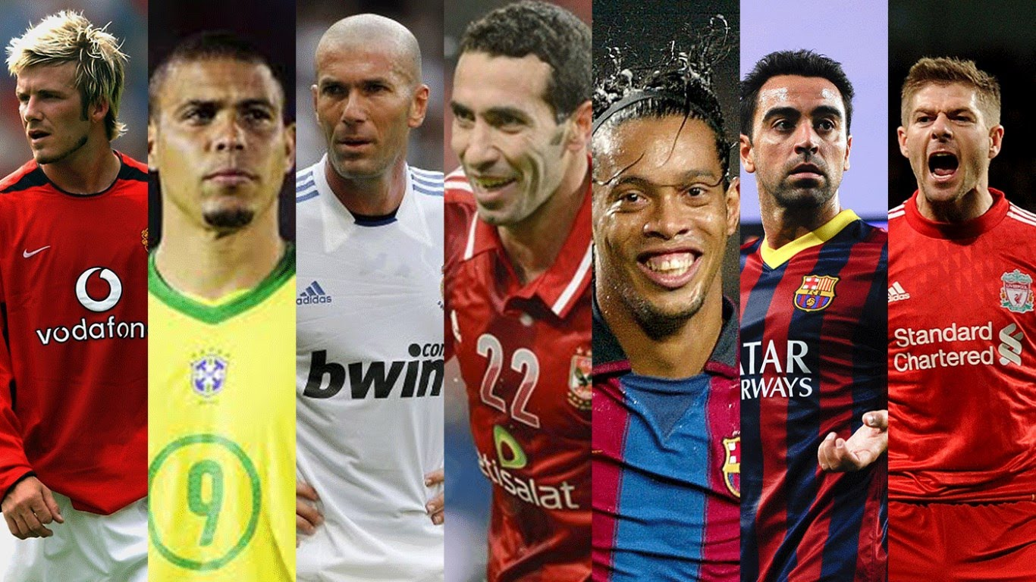
Suggestion for Wayne Ho Channel
Wayne Ho Should make some video talk about the basic rule of football .
Example: Free Kick, Penalty Kick, Handball, Offside
To attract female audience.

Slide 5
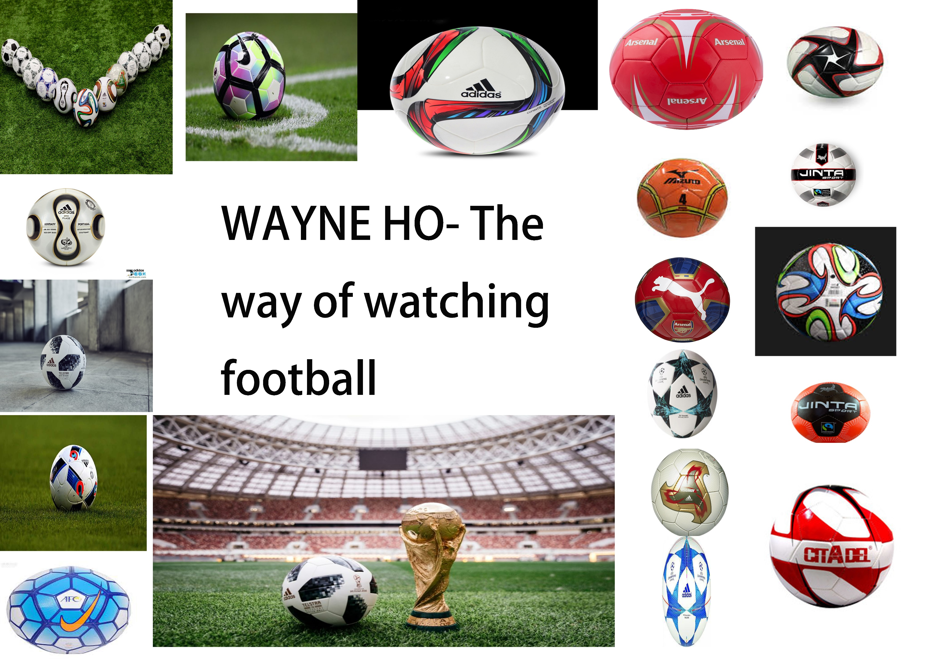
Mood Board

Slide 6

Wayne HO-Web Page

Slide 7

Output-interview

Slide 8
Refence
Wayne Ho YouTube Chenal
https://www.youtube.com/user/waynehk07
Google Photo
World Cup Song
Wayne Ho

