Slide 1
傳承「心」的旅途

Slide 2
Engaging, Interactive, Connecting
Engaging, Interactive, Connecting
Engaging, Interactive, Connecting
參與，互動，連接

Slide 3



The Core Issue
01
02
03
Awareness
Quality And Diversity
Of Products
Logistics

Slide 4



Target Audience
Student
Middle Class
Active Social Media User
($10,000 to $40,000 HKD per month)

Slide 5




Audience Analysis
Emotional: Item deserve better treatment
Donating items is meaningful if it really helps
Traditional collection methods are trouble and boring
Season changes, Fashion changes

Slide 6
Hong Kong Youth Media Usage
92.4%
90.7%
84.8%
86%
84.4%
84.9%
75%
79.7%
78.4%
Gain Information
Derivative Work
Send Message
Facebook
Video Clip
YouTube
WhatsApp
Instagram
Music
General Use
Use for
Source: RTHK 2016 年度新聞與社交媒體使用行為調查

Slide 7
Client Analysis
01
Involve more creative people
03
02
New activity style
Social media management

Slide 8
Proposition
Item have its own trip
just let them go and give them our best wishes

Slide 9

傳承「心」的旅途

Slide 10



Campaign Promotion
Stage 1
Stage 2
Stage 3
Raise the Awareness
Video Contest
Take The First Step

Slide 11
Stage 1
Importance of Check-in & Tag
Check-In & Tag Friends
Social Media “Check-In”
Audience take photos for the event
4
Events
2
Social Media Sharing
E.g.「Season of Love」「2人3足勵同行」
Audience share the photo and experience of event
1
3

Slide 12




Stage 1
Importance of Check-in & Tag
Low Cost
Share and Tag
Potential Of Great Reach
Social Media Spread

Slide 13
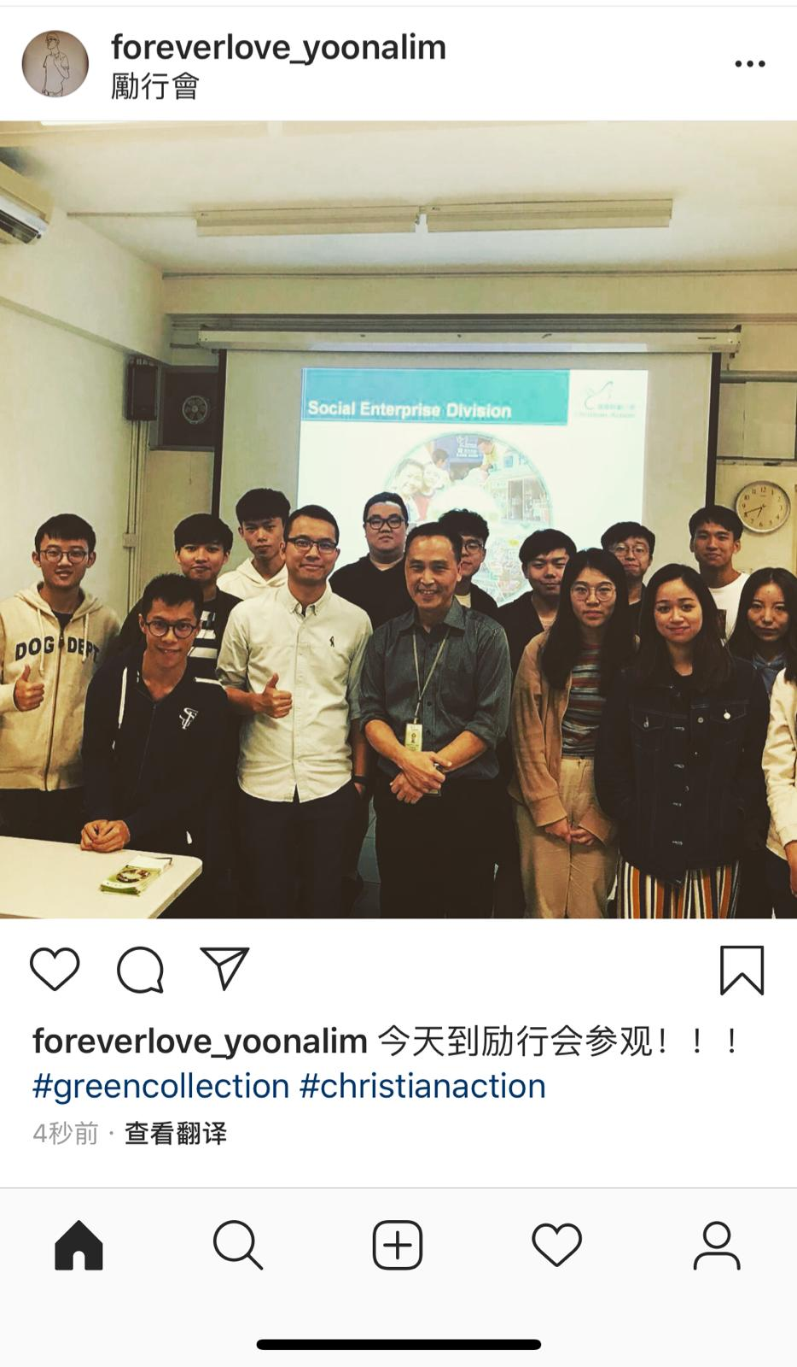

Social Media layout
Instagram

Slide 14

Stage 2
Online Video Contest

Slide 15



Stage 2
Online Video Contest
“它和我的故事” video contest
Audience created video
Launched on Facebook

Slide 16



Stage 2
Online Video Contest
Rules
Personal Item Memory
Video less then
2 minutes
Post Video with ”它和我的故事”
In video title

Slide 17
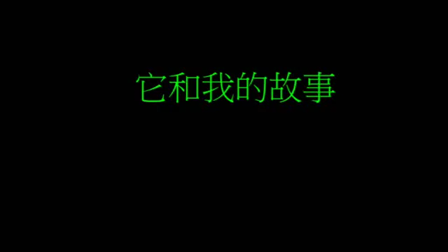
Stage 2
Demo

Slide 18
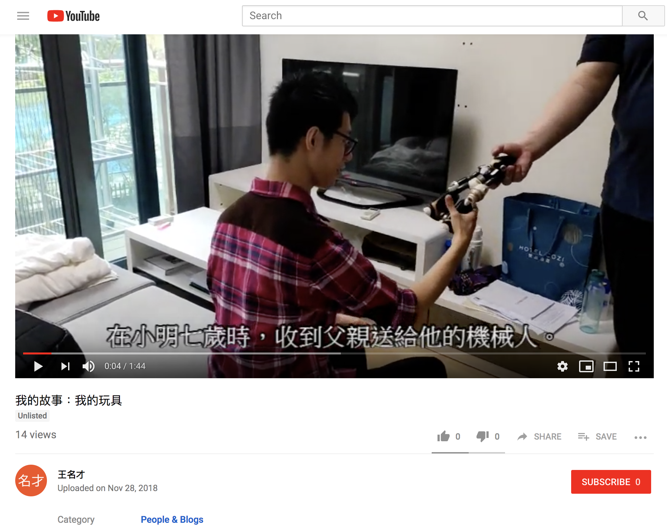

Social Media Layout
YouTube

Slide 19
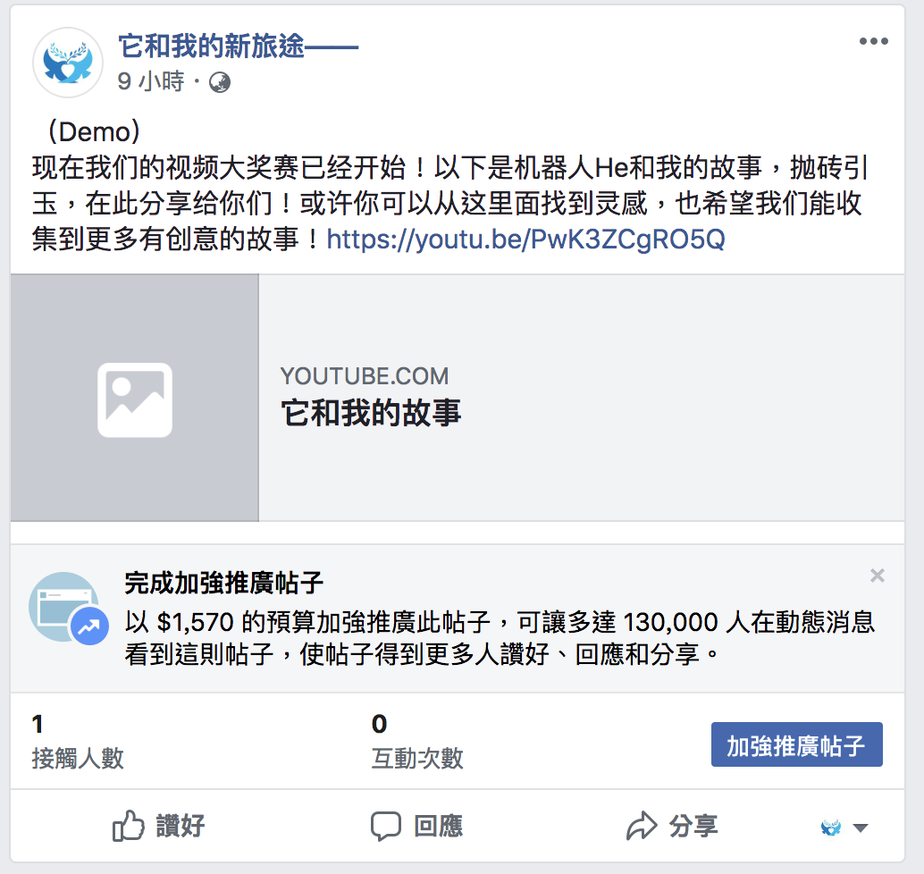

Social Media Layout
Facebook

Slide 20
Schedule
1) Registration : 1st December - 8th December
2) Production: 9th December - 20th January
3) Network Mass Evaluation:
21st January - 28th January

Slide 21

Stage 3
Take The First Step

Slide 22


Stage 3
01
Collect the Item
Participants of video competition submit the item
Write a few words to the item
Special area for those product
The few words of the donor will be shown
Buy the item through the reply
Acknowledge owners the follow up development

Slide 23


Stage 3
Status Record
Photo daily updated
Post on the Fan-page
Final Step
Comment under the post
Give feedback to original owner

Slide 24


Stage 3
02
“ Crafts Production Workshop ”
Workshop + Online Sale
Purpose
Help grassroots citizens with useful handmade production skills
Promote the environmental concept of “Green Collection”
Let social media user connect with grassroots

Slide 25
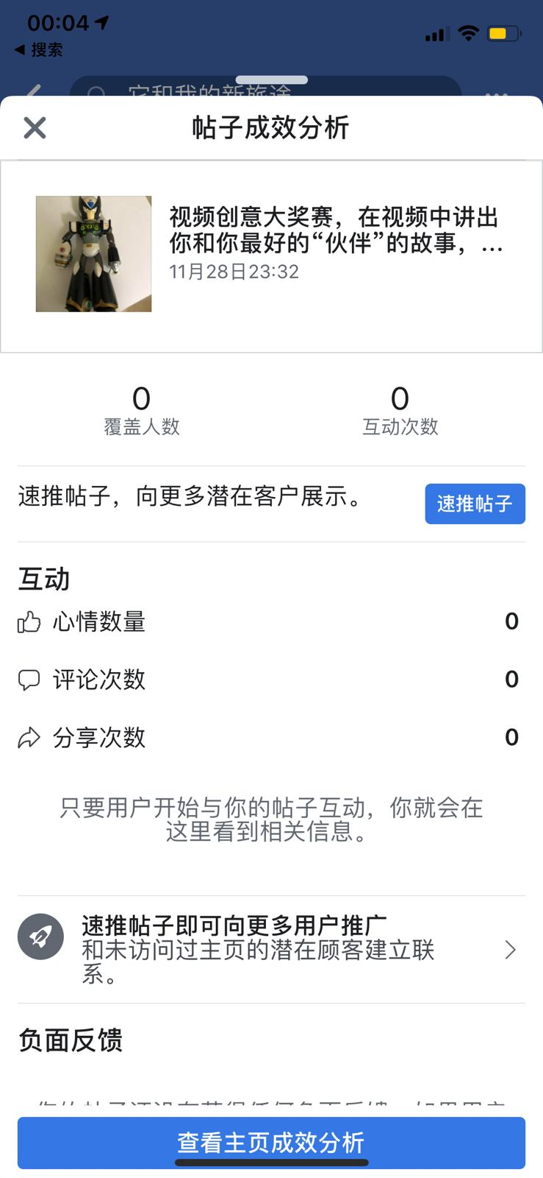
Social Media layout
Facebook

Slide 26
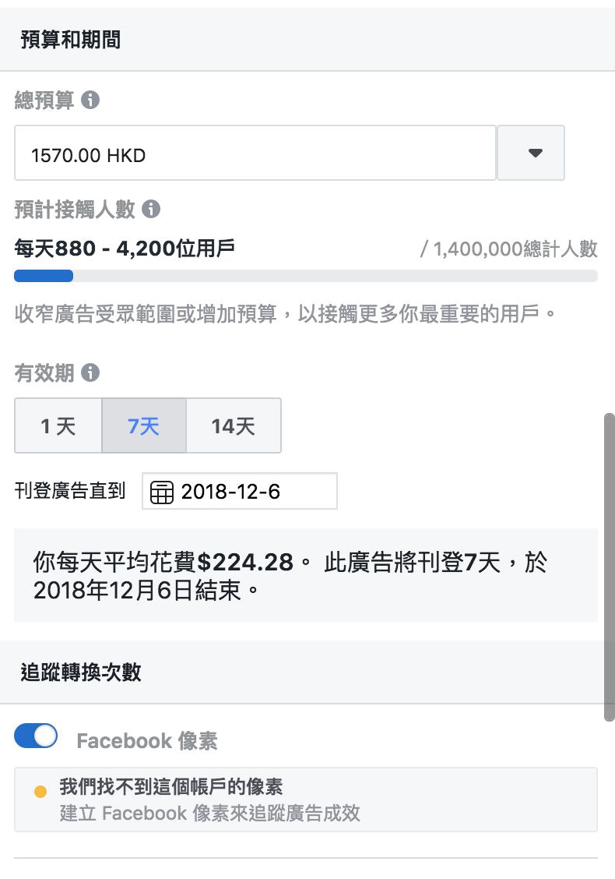
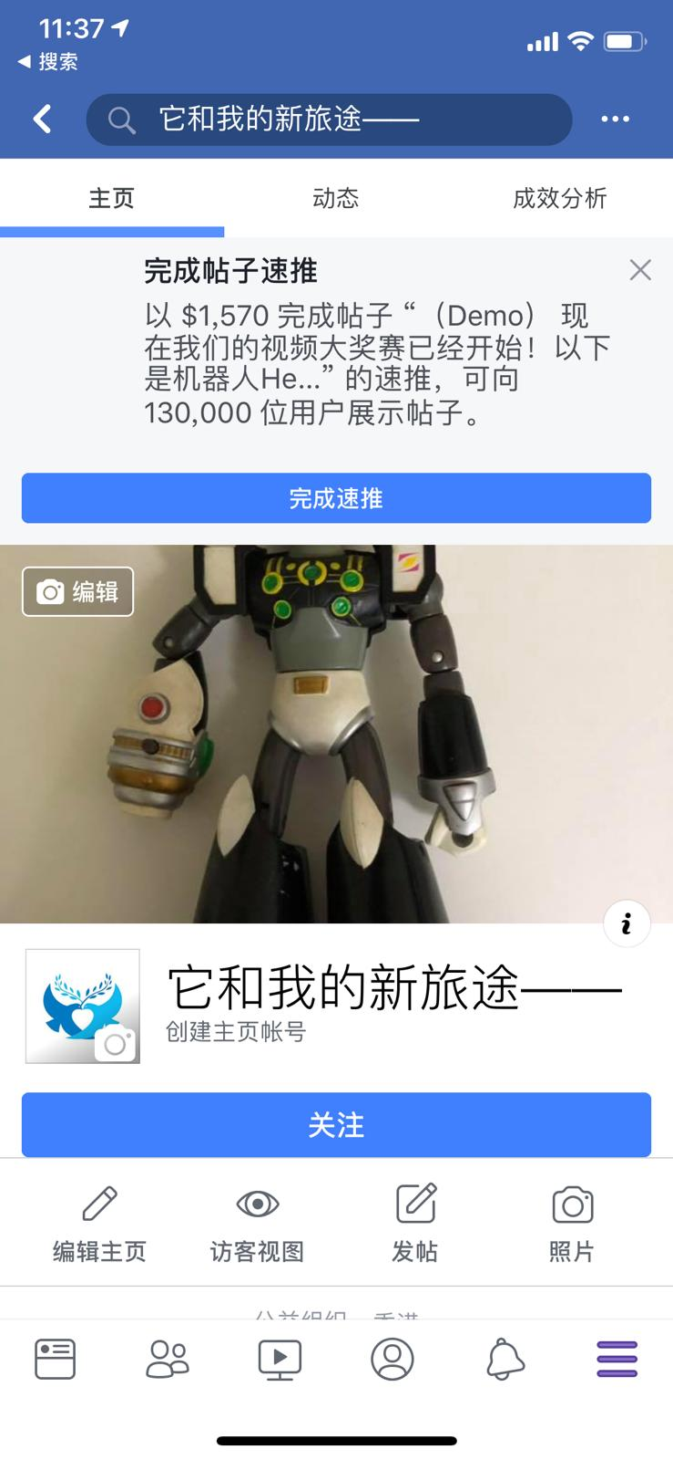
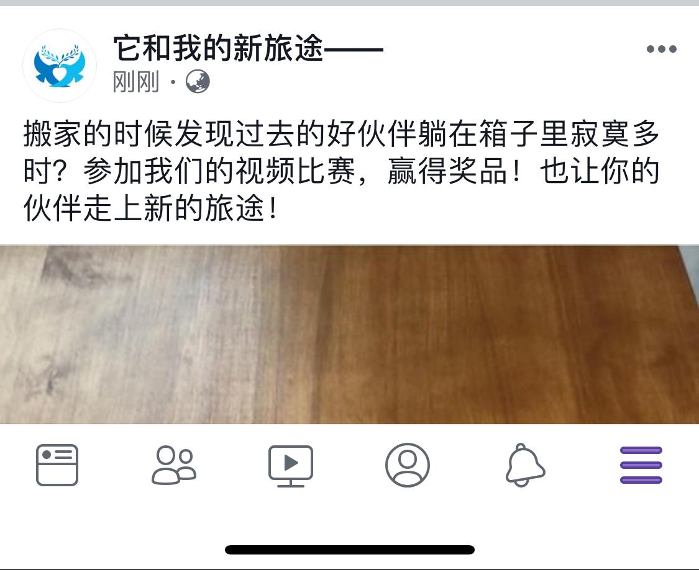

Slide 27
Budget
01
03
Facebook Advertisement
$224.28 x 7Days= $1570
Special Area
L
02
1.Concert ticket: $800 x 2 = $1600
2.Super Market coupon: $500
3.Apps Store Give Card : $200

Slide 28
Thank You
Thank You
Thank You

