Slide 1
SiNg fest FUNDRAISING
Wong Ming Choi 19661150
Cheng Ka Chun 19661748
Cheung Cheuk Fung 19661008

Slide 2
oRGANIZATION INTRODUCTION
Sing Fest, a organization to provide the highest quality of performances and innovative educational opportunities connecting local vocalists,audiences and donors.
Sing Fest aims to inspire humanity through the beauty of music by more exciting programmes.

Slide 3
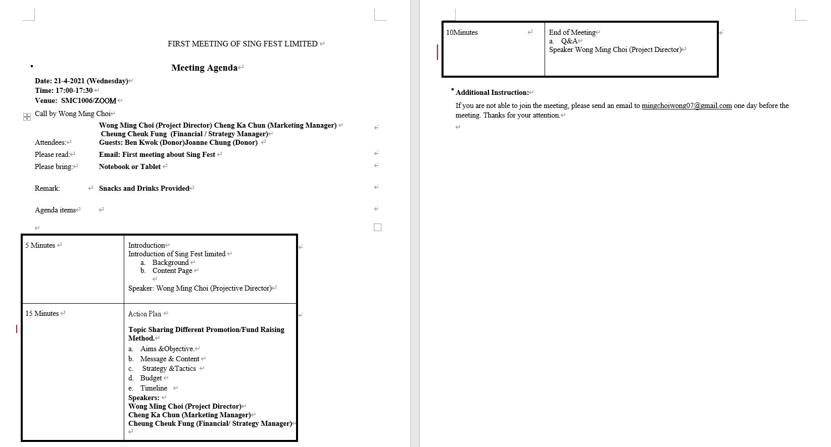
Meeting Agenda

Slide 4
TABLE OF CONTENTS
01
02
03
STAKEHOLDER
MESSAGE AND CONTENT
Aims AND Objectives
04
BUDGET
STRATEGY AND TACTICS
TIMELINE
05
06

Slide 5

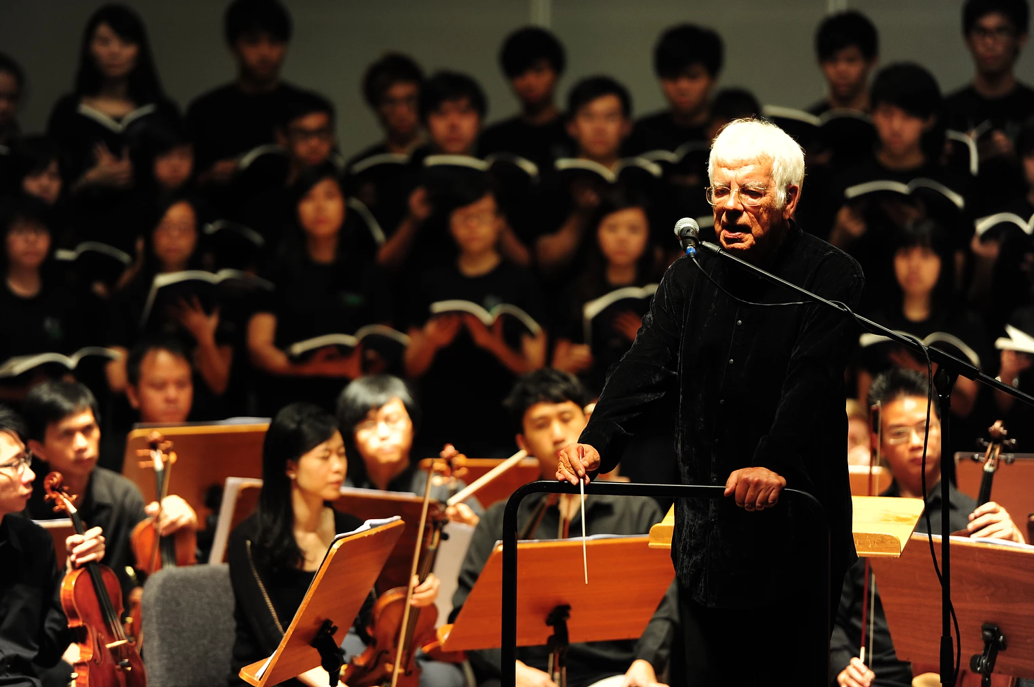
The Memory of
Hong Kong
回憶中的香港

Slide 6
01
AIMS AND OBJECTIVE

Slide 7
aiMs & oBJECTIVEs
AIMS
Fundraising
Objective
Connect Hong Kong People together
Attract Hong Kong People to donate money
Giving positive support to Hong Kongers
Let Hong Kong people proud to be a Hong Kongers

Slide 8
02
STAKEHOLder

Slide 9
Stakeholder
Audience
Venue Support
Key Opinion Leader
Donator

Slide 10
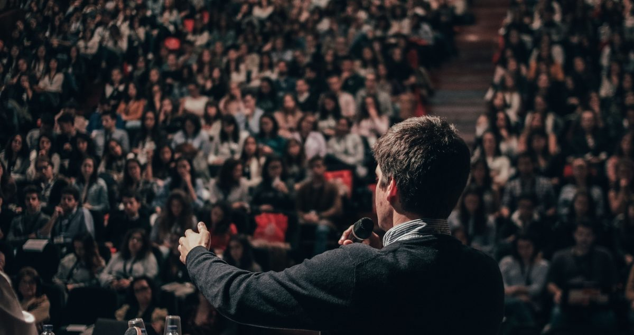
Audience

Slide 11
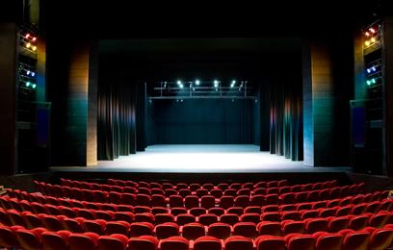
Venue
Kwai Tsing Theatre Auditorium

Slide 12
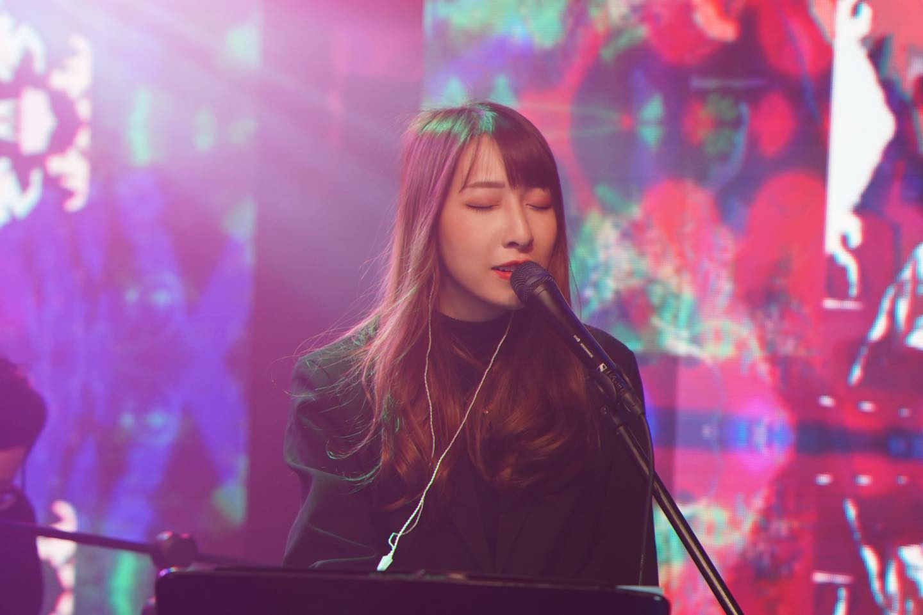
Key Opinion Leader
小神經 Little Nerve
Hong Kong indie internet singer-songwriter
Original compositions featuring only guitar/keyboard as accompaniment

Slide 13

Donator
People Who Love Hong Kong Pop Culture
People will frequently donate money
People who enjoy memories of Hong Kong

Slide 14
03
MESSAGE AND CONTENT

Slide 15
CONTENT & MESSAGE
Content: Making Hong Kongers in memory of important historical moments
Message: Resonating with audience,make them feel be proud of being a Hong Konger

Slide 16
04
STRATEGY AND TACTICS

Slide 17
Strategy
Holding a concert
Carnival activity
Singer play the relevant songs according different period of Hong Kong.
Create positive emotion of Hong Kongers
Setting a few small booths for place the exhibition which described the event detail

Slide 18
OUR STRATEGY
Strategy
Using a music show to encourage Hong Kong people and bring back the shared memories and values of the past in Hong Kong
Why using this strategy?
Music should connect everyone (reason why no target group)
Shared common ground
Responding to the current situation and atmosphere of Hong Kong
Goals of the strategy
Gain more income for SingFest
Increase the awareness of Hong Kong people about SingFest
Increase the interest of Hong Kong people on classical music

Slide 19
OUR tactics
Song Suggestions
Cantopop
Different Ages
Different Background
Cultural Identity
Positive Value
Song list
友情歲月
當年情
共你痴痴愛在
每當變幻時
海闊天空
獅子山下
山林道
大城小動
願
未來見
Encore: 最後的信仰

Slide 20
1 hour programme (With Encore)
Rearrange the songs to suit the performance style of Sing Fest
Invite local band and singers (KOL) to cooperate with music arrangements

Slide 21
sHOWING DEMO

Slide 22
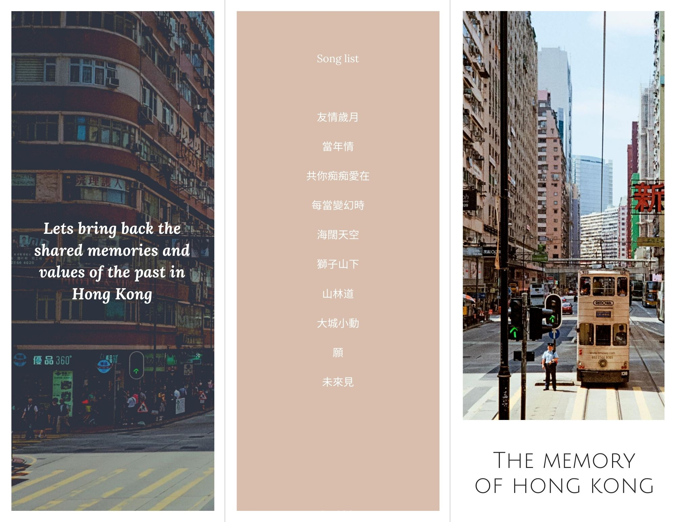
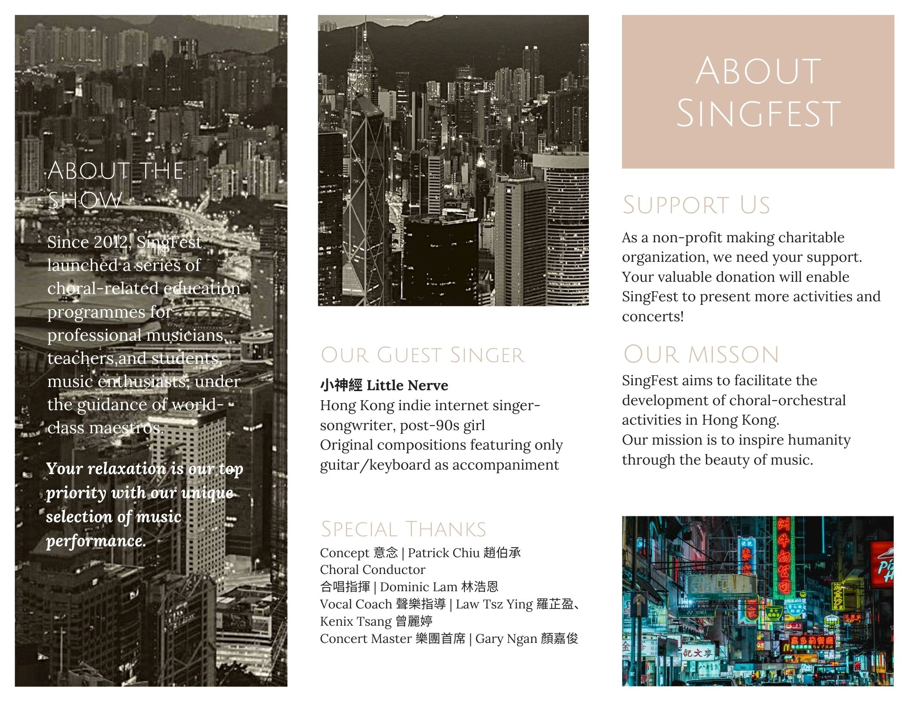
Leaflet

Slide 23
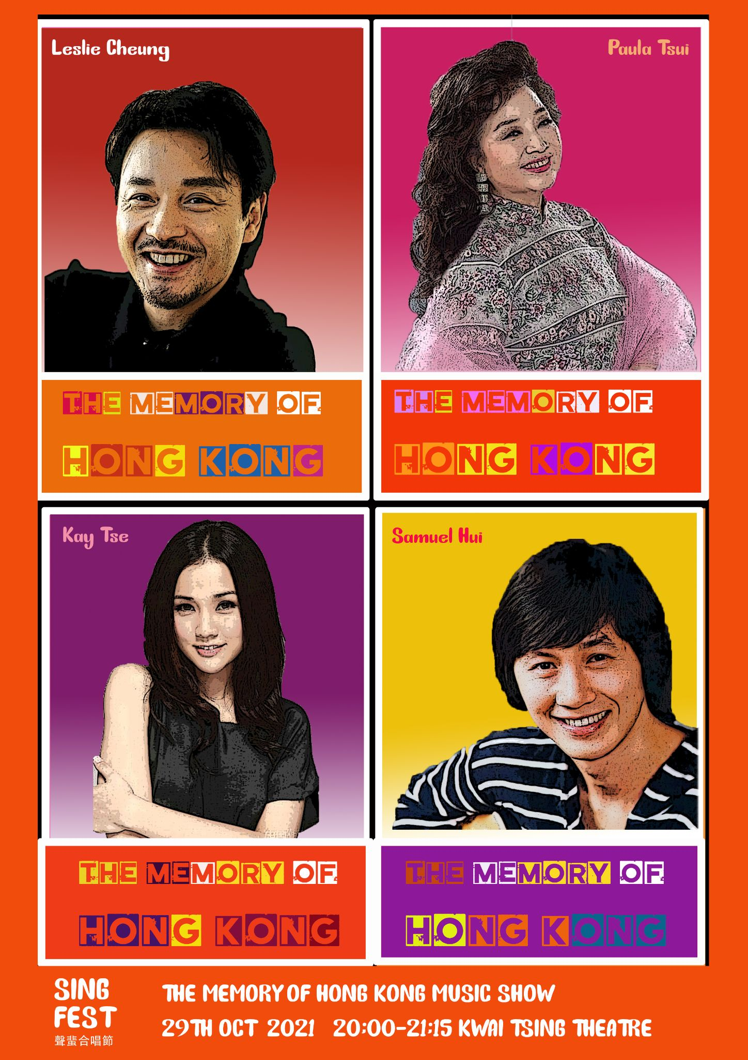
Poster Design
The Music Show Poster
4 celebrities represent different period of Hong Kong

Slide 24
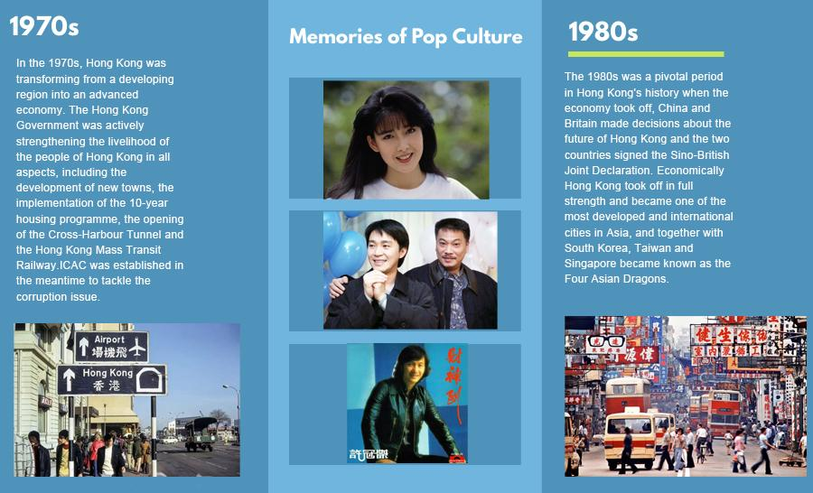
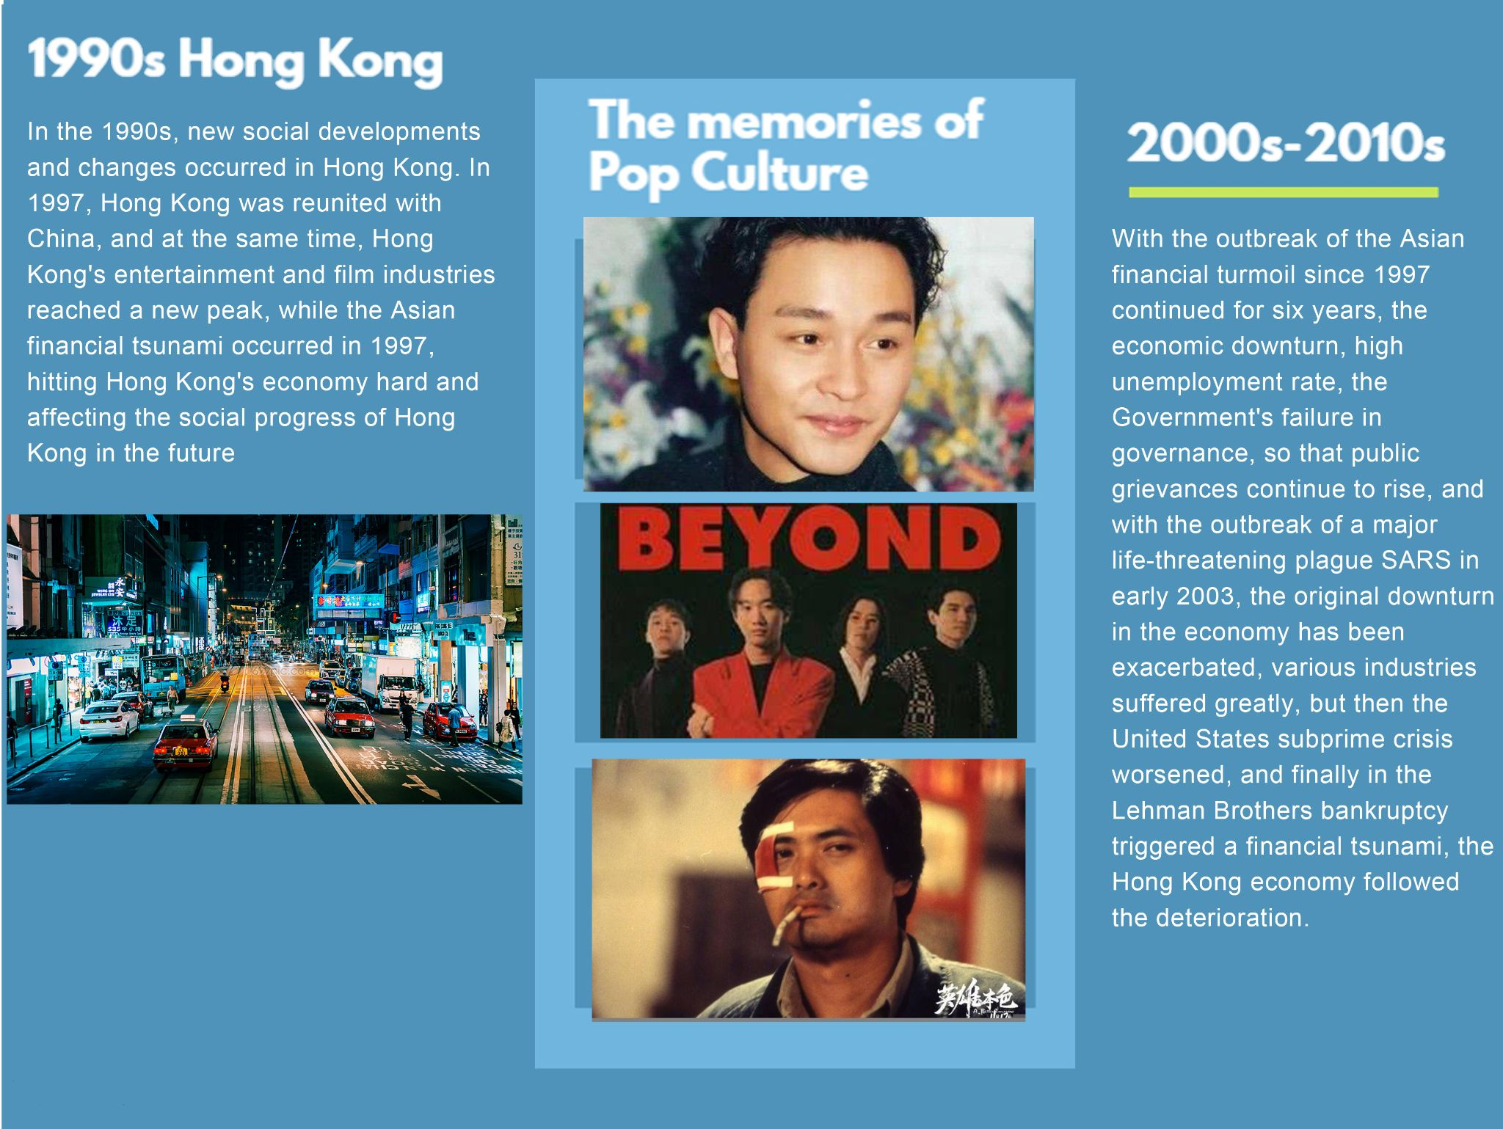
Exhibition Board Demo

Slide 25
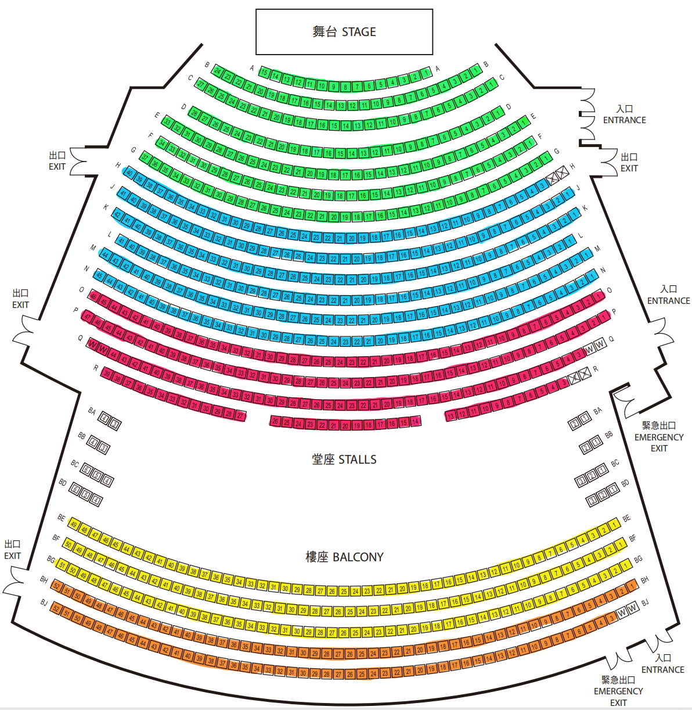
Seating Plan Of The Show
This is the floor plan of Kwai Tsing Theatre Auditorium.
We separate the areas by colour
Green zone suitable for children and elders
Other three zones suitable to different audience groups

Slide 26
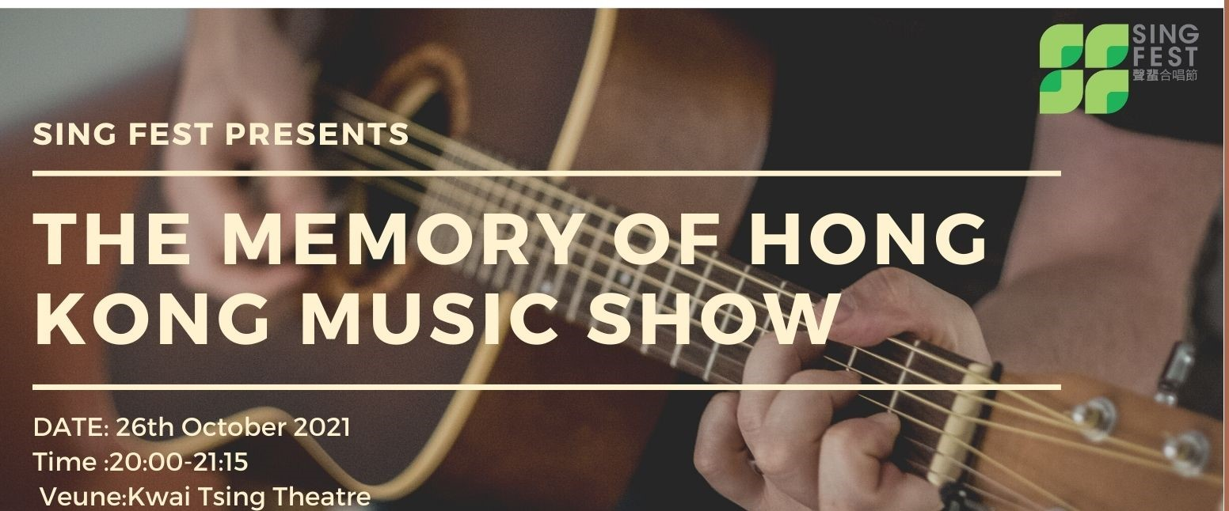
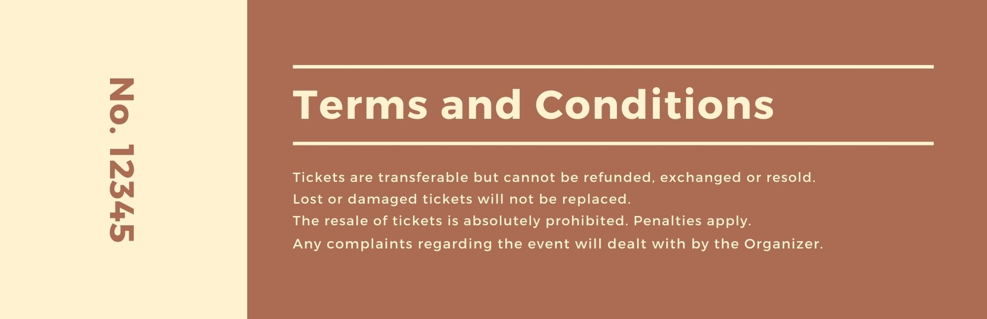
Demo of Ticket
This is ticket demo of The Memory of Hong Kong Music Show

Slide 27
SHOW CONTENT DEMO
https://www.youtube.com/watch?v=dSSM_peLKCk

Slide 28
05
BUDGET

Slide 29
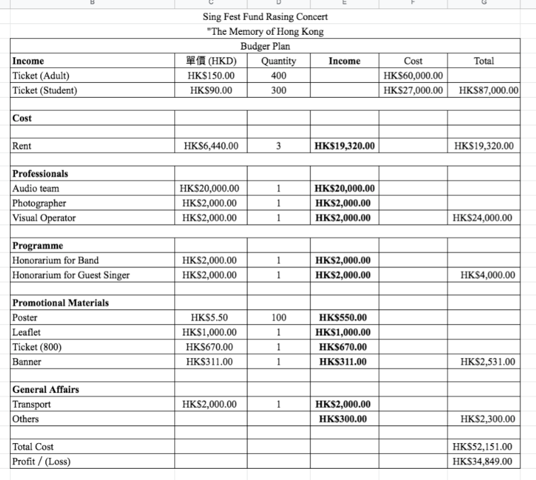
BUDGET

Slide 30
06
TIMELINE

Slide 31
Timeline For Campaign
Booking venue
Planning campaign
Funding
10-26
Show start
Invite guest
2021 APR
2021 MAY
2021 JUN
2021 AUG
2021 SPE
2021 OCT
2021 JUL
Recruit the staff
Ensure the resource usage
Design promotion leaflet posters cardboard
Ticket
Social media promotion

Slide 32

Q&A

Slide 33
rEFERENCES
【歌手表演】2021年最新歌手表演價錢指南
https://freehunter.hk/news/%E3%80%90%E6%AD%8C%E6%89%8B%E8%A1%A8%E6%BC%94%E3%80%912020%E5%B9%B4%E6%9C%80%E6%96%B0%E6%AD%8C%E6%89%8B%E8%A1%A8%E6%BC%94%E5%83%B9%E9%8C%A2%E6%8C%87%E5%8D%97/
葵青戲院
https://www.lcsd.gov.hk/tc/ktt/index.html

