Slide 1
IVF
Campaign
Chan Wai Chau, Peter 196661002
Hu Shun Tin, Cookie 19661037
Lee Fung Ling, Bea Nicole 19661126
Wong Ming Choi, Tom 19661150
Yuen Lan Fong, Mandy 19661231

Slide 2
Agenda
Situational analysis
Competitor
Aim
Objective
Target audience
Message
Strategy
Online promotion
Offline promotion

Slide 3
Situational analysis
01
02
-Communication channels
-Marketing activities
To educate people and increase the knowledge of IVF
New technologies develop/IVF technologies improved
Competitor
Lack of Social awareness Of IVF
birth rate decreases
People get marry/ pregnancy at late age.
Internal environment
External environment

Slide 4
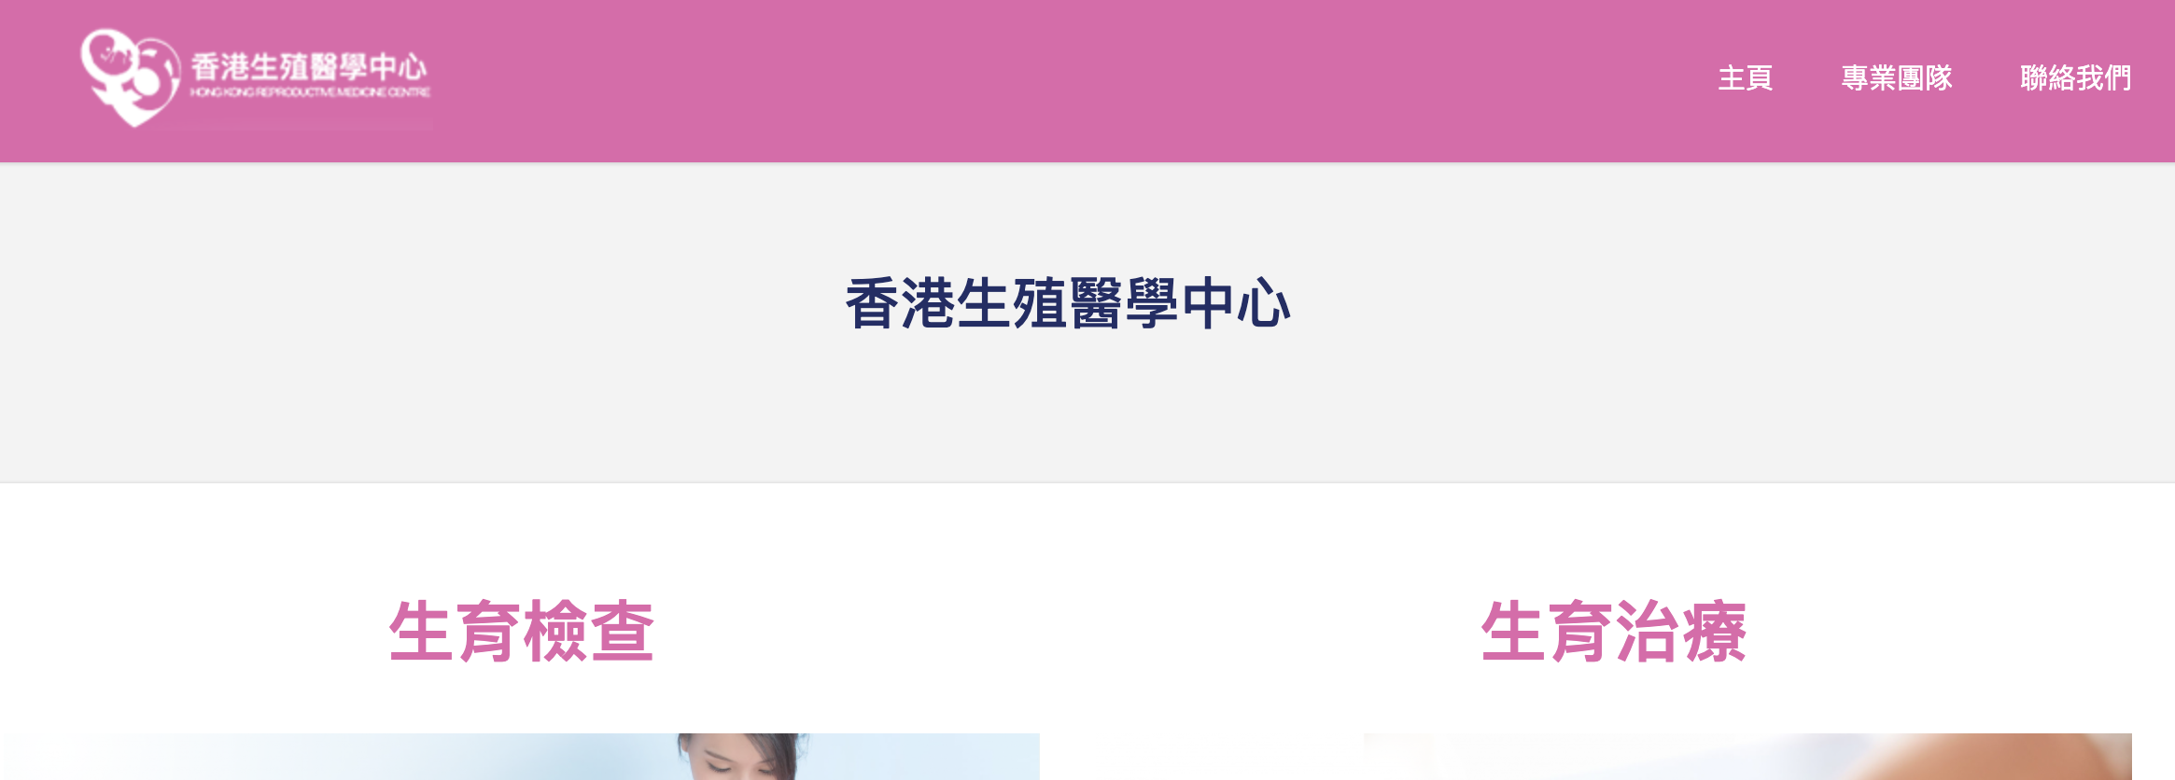

Competitor
The Women's Clinic Group
Hong Kong Reprodction Medicine Centre

Slide 5
Campaign

Slide 6
Target audience
Age | People aged 28-45
Sex | Both Men and Women
Lifestyle | Lack of work life balance, stress, unhealthy behaviour( Smoking,alcoholism, Age, tamplture)
Attitude | Actively try to have baby/Passive about having a baby

Slide 7
Education level in both sex
Age Group (Male)(‘000) |  |  | Education Level | Age Group (Female)(‘000)
20-29 | 30-39 | 40-49 |  | 20-29 | 30-39 | 40-49
None | 0.4 | 0.7 | No schooling/Pre-primary | 0.7 | 1.6 | 4.9
1.3 | 3.0 | 11.7 | Primary | 5.0 | 21.3 | 50.9
81.9 | 55.0 | 43.1 | Post- secondary -non-degree | 76.3 | 71.6 | 49.6
222.2 | 205.0 | 152.8 | Post- secondary -degree | 258.3 | 251.6 | 168.2

Slide 8
Personal Income
Male
Female
Median Monthly Employment Earnings(HK$) | Age | Median Monthly Employment Earnings(HK$)
16000 | 20-29 | 15600
23000 | 30-39 | 20000
25000 | 40-49 | 18700

Slide 9
Barrier of TA
Social Discrimination
→ Not willing to open up
→ Less publicity
lack of understanding of IVF

Slide 10
Aim
Educating target audience about IVF

Slide 11
Objective
Clarifying the concept that taking IVF is not shameful
01
02
Introducing the topic of IVF to TA
(Reducated)

Slide 12

IVF, SO WHAT!
人工受孕，
咁又點?！
Theme

Slide 13
Message of the Campaign
Message:
Taking IVF is normal, nothing to be shameful about.
Providing IVF information to our TA
Slogan:
IVF is hope
Hashtag:
#IVFSoWhat #WHYNOTAKEACTION

Slide 14
Theory/ Model
Theory of reasoned action
  Focusing on changing people’s attitude towards IVF
  Making them believe IVF is a good alternative ways to get pregnant
  Clarifying that infertile couple is not just the women’s problem
Notes:
Using the online and offline media to create a social issue of the IVF
Normalize the concept of IVF by giving information and clarifying the misconception

Slide 15
Strategy (Approach-oriented individuals)
Behavioral Beliefs：
  IVF can increase the possibility of pregnancy, especially for infertile couple
Outcomes Evaluation：
  Higher chance of getting pregnant and having a child for them own
Normative Beliefs：
  Understanding the factor of causing pregnancy difficulties
  Making couple’s family members belief IVF is a way to solve the couple’s pregnancy difficulties and give support
Motivation to Comply：
  Promoting being infertile and taking IVF is normal
  Clarifying and normalise the topic in IVF

Slide 16
Television commercial
Reach out the most public and create the most awareness
Give out basic knowledge on infertile couple and IVF
Assume “Sensitive” topic openly expose in the media would create a topic among the society
Exposing the topic of IVF to normalise the topic taking IVF
-> with gain-framed message to get what the TA desire
E.g. IVF can increase the possibility pregnancy and higher chance of overcoming the pregnancy difficulties

Slide 17
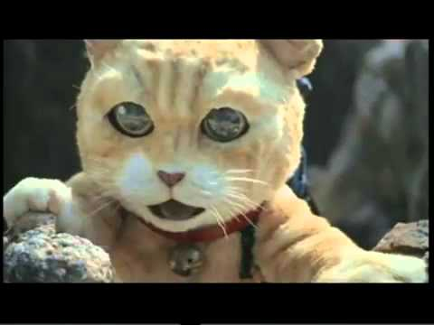
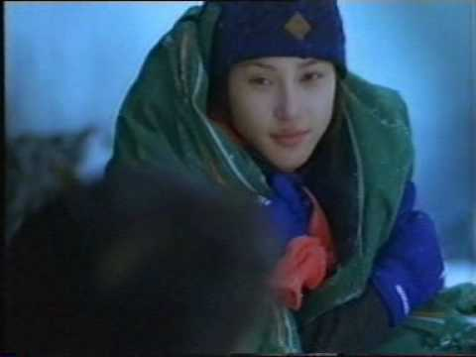
Story Reference

Slide 18
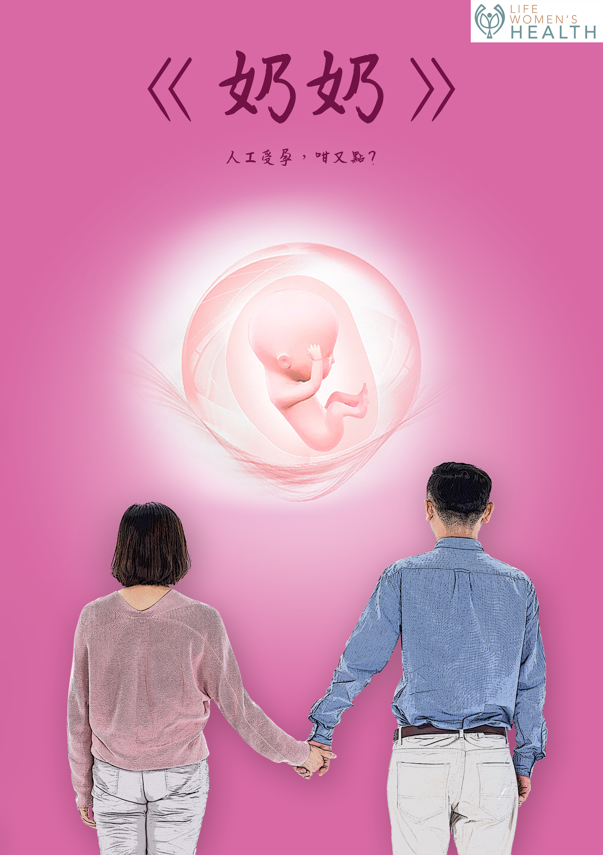
TVC - So What! series
Three episode commercial series
A commercial which use “Mini-Film” to process.
In order to catch the eye of audience, the commercial would be separate into THREE episode.
Each episode would play around 30 second.
Launch it in the Golden Time.

Slide 19
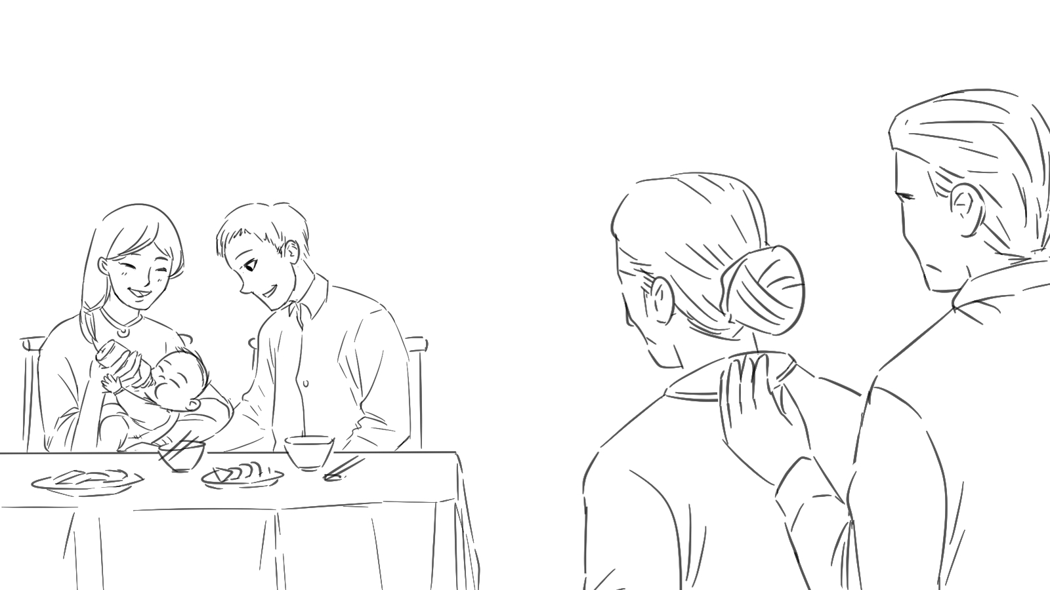
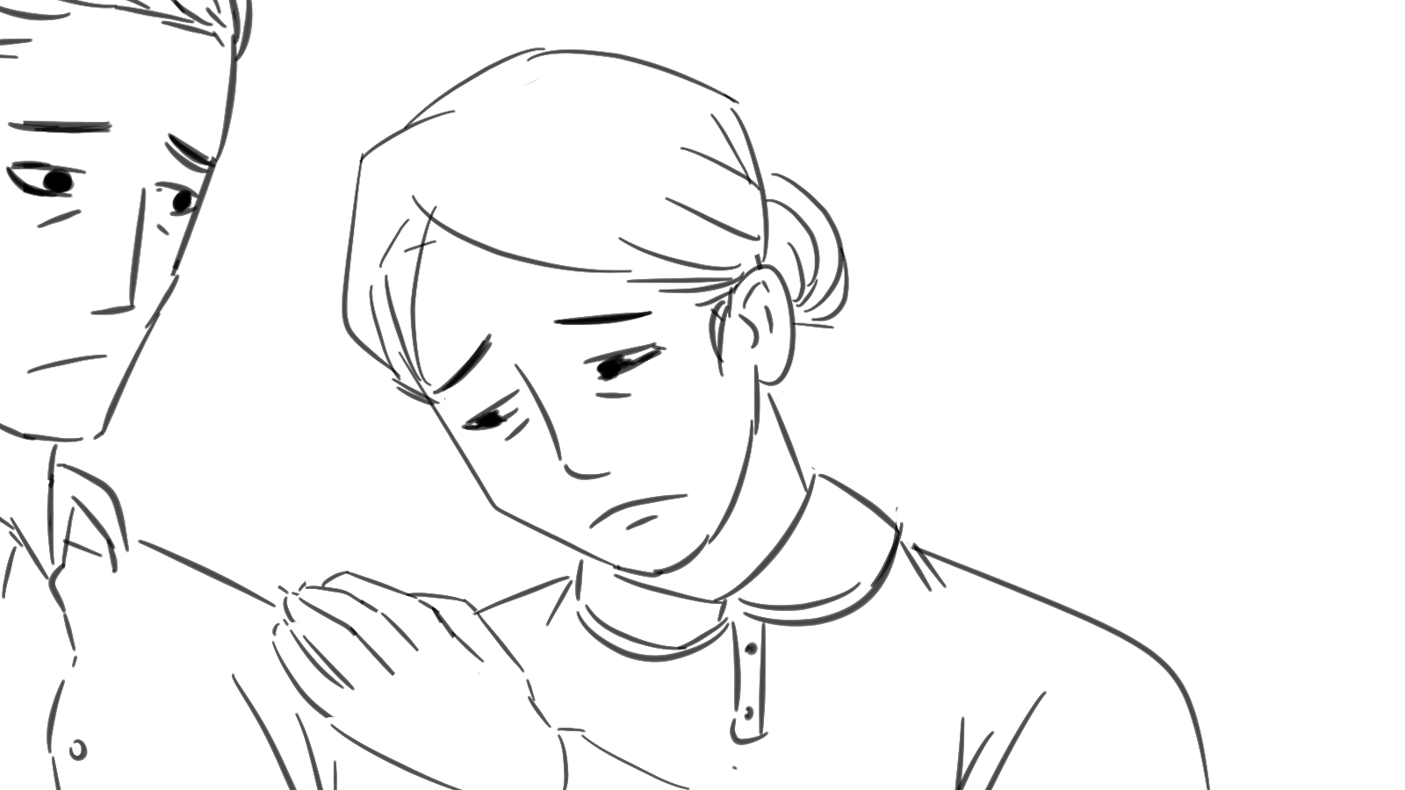
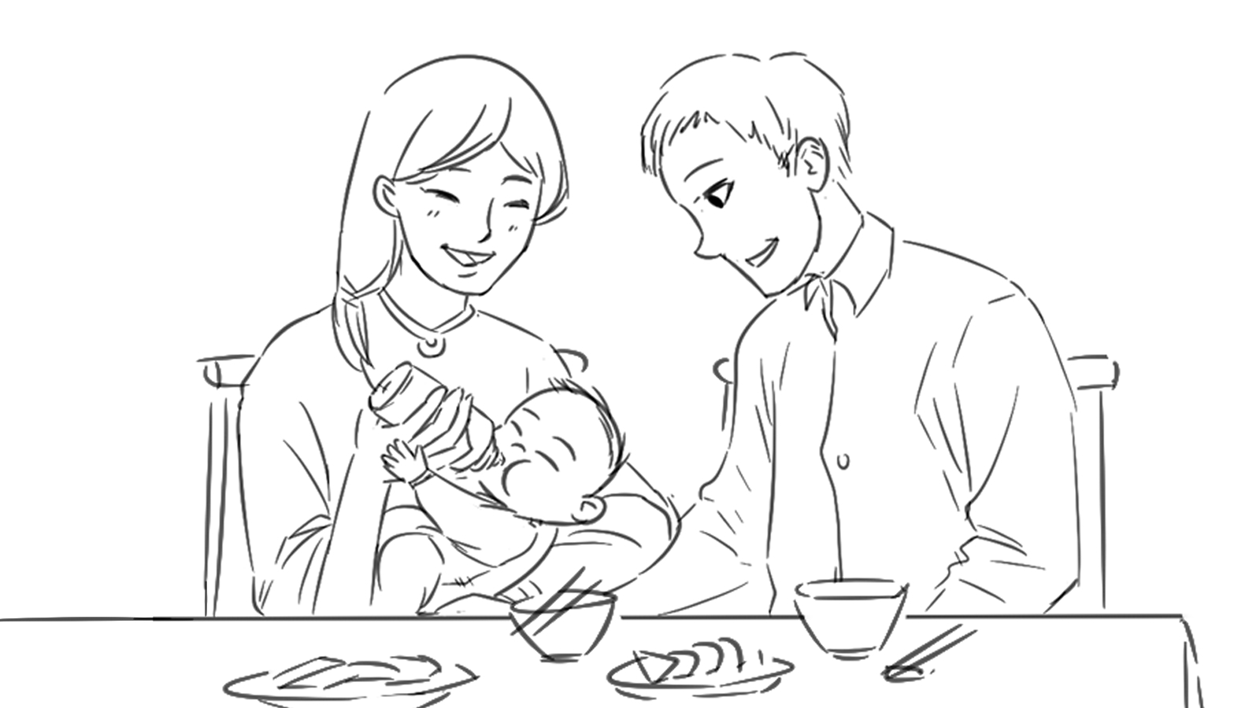
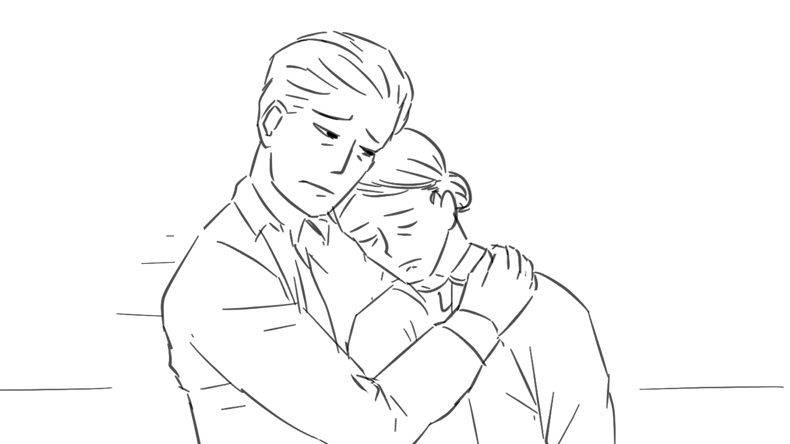
TVC - So What! series
Three episode commercial series
1st episode: The “old” aged couple looking at another young couple taking care a child happily in the restaurant, the woman looks disappointed and her husband trying to comfort her without a word (creating curiosity)

Slide 20

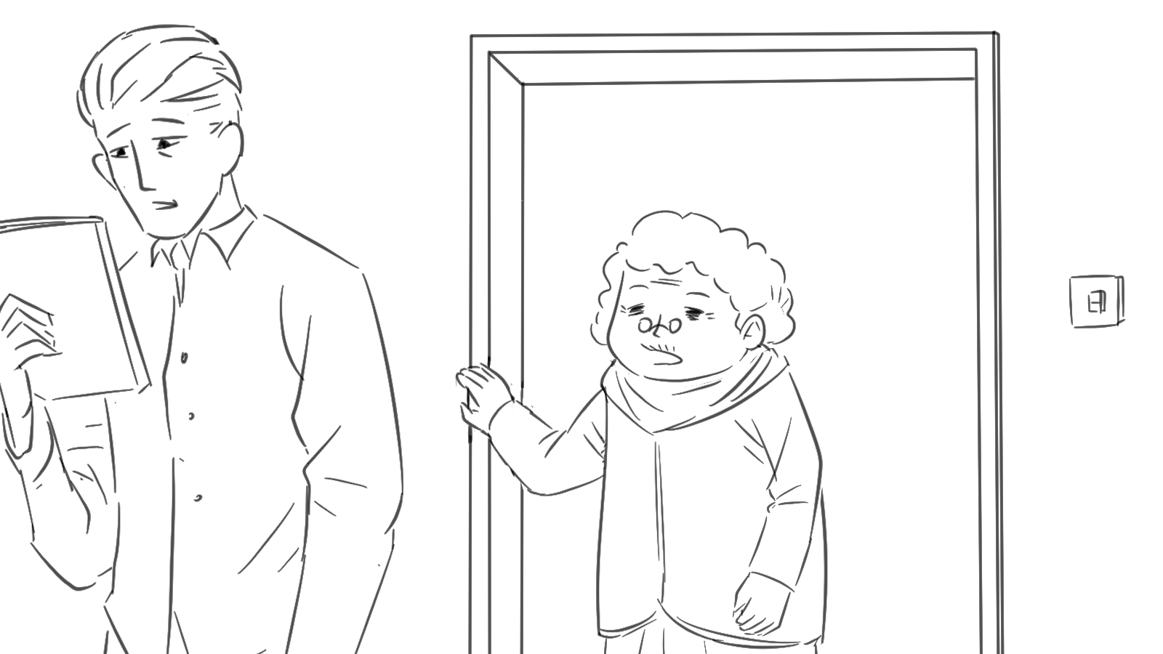
TVC - So What! series
Three episode commercial series
2nd episode: The “old” couple searching something secretly and discuss. Suddenly, the woman mother-in-law burst in the room and ask her what they’re looking at. They look shocked (cliffhanger)

Slide 21

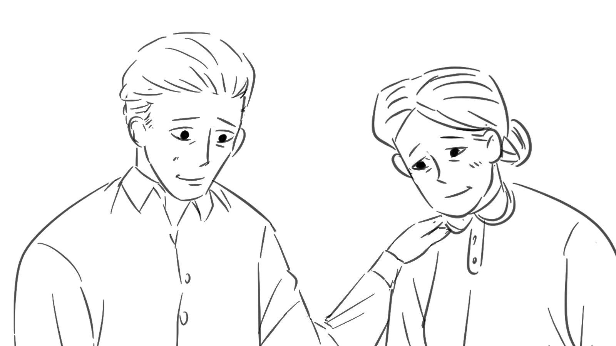
TVC - So What! series
Three episode commercial series
3rd episode: The couple feel embarrassed and scared but the older woman stated it’s fine and giving facts and information in the current situation and give her support to the couple (twist & resolution)

Slide 22
TVC
Three purpose in this commercial series
Create the attention to attract different people keep watching the story in the commercial
Open the topic to the public while give out information to educate public and encourage TA to speak out their desire for child
Encourage the family member of the TA support them

Slide 23
TVC - Operation
1st and 2nd episode: Emotional content
3rd episode: Emotional content + Rational Content
2 week promotion for episode 1-2
  To increase the curiosity
  Attract attention
1 week promotion for 3
  Reveal Topic
  Normalise topic
30s-45s per video

Slide 24
Online-Facebook/ Youtube/ Website
Online Media -YouTube, Facebook,
Re-watch the TVC
Create the interaction
- Like, Share, Comments
Caption:
Taking IVF is normal, nothing to be shameful about.
Providing IVF information to our TA
→ Keep the post short and use video where possible to catch the eye of the reader
→ share via the link to your Facebook page, traffic to your website to seek more information
Notes:
Message:
simple information about IVF and the brand
For more further information
→ place a QR code,
drive the TA attention to the website to seek more information:

Slide 25
Clinic/ Private Hospital (婦產科)
Distribute the Print ads after the TVC series launched
Print ads
Poster
  Emotional
Leaflet
  Informative
→ It helps you get your services in front of potential patients. When they see your ad, they determine if they need your services.
→ If they do, they’ll likely scan the QR code that drive them to your website
→ Directly target our TA

Slide 26
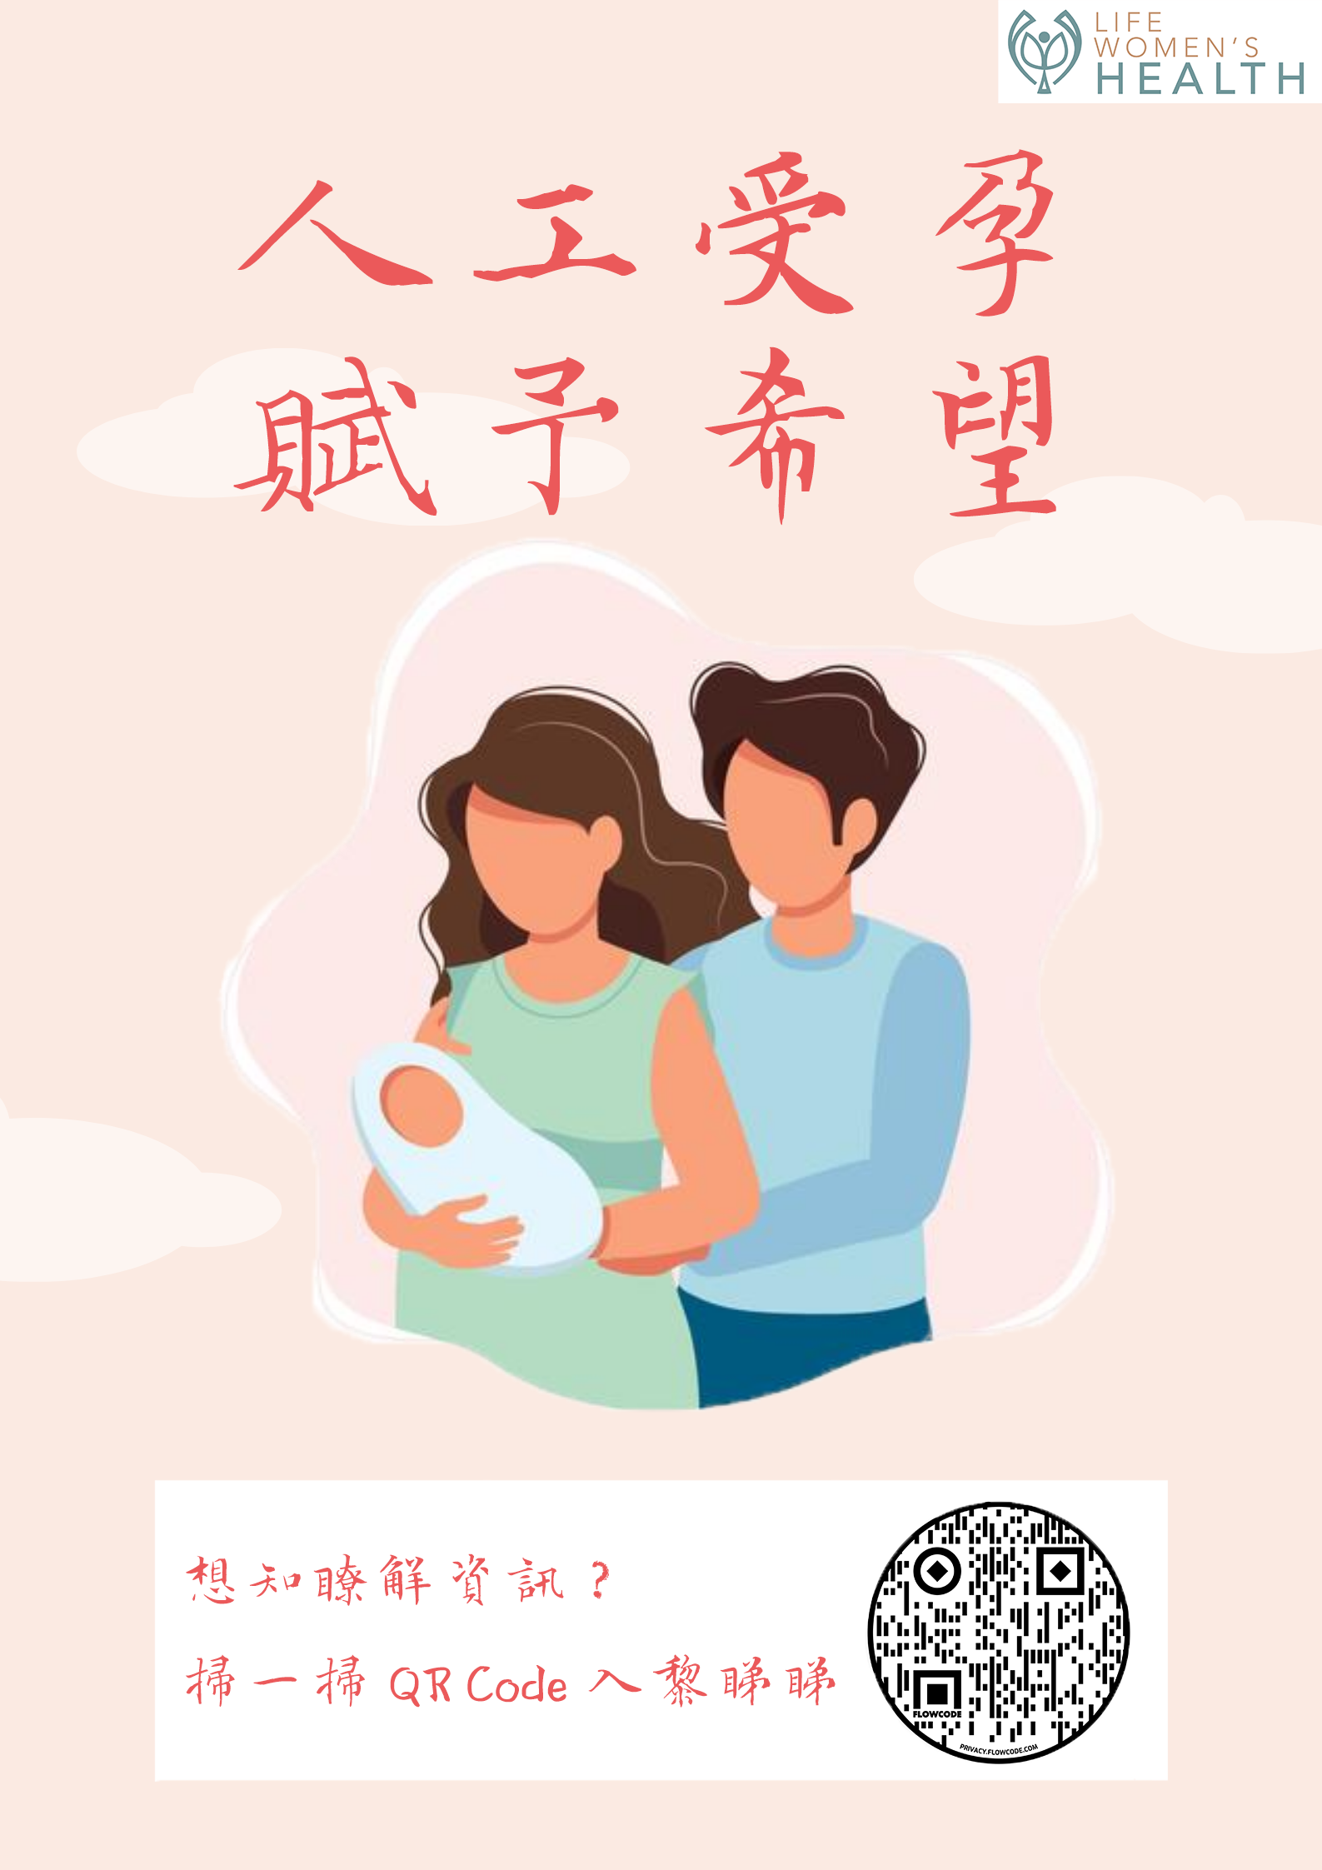
LOGO
Show your company
Slogan
To catch the attention of people and tell the message simply.
Graphic
Use cartoon style image is better than real people as it’s more novel.
Information
Use a question to arouse people's curiosity and scan the QR Code to know more information
QR Code
The most quick way to transfer your message nowaday.
TEXT: Question?
Let’s check it…...

Slide 27


Graphic
Because this is a leaflet
So it’s important to point out the theme through picture directly.
Slogan
To catch the attention of people and tell the message simply.
QR Code
Put if you want
Go the Official website
Question
To strike chords with people who are facing this problem.
LOGO
Show your company

Slide 28

TEXT
The definition of IVF
Introduction
The definition of Infertile Couple
Introduction
TEXT
Benefits of IVF
Promotion
TEXT
The difference between 3 generation IVF technology
Promotion
TEXT

Slide 29
SEO Marketing
Generate a list of keyword ideas that are relevant to your website
Keywords:
IVF
IVF Pregnancy
Fertility Doctor
IVF Success Rate
IVF Procedure
→ more visibility gain on Google and other major search engines
→ the more website traffic you’ll receive, which increases your potential to get more patients.

Slide 30
Zoom talk
Clarify the misconception on infertile couple
Giving a more detailed introduction on IVF
  What is IVF?
  Process of before to after taking IVF
  Possibility of pregnancy from taking IVF
  Technology etc..
Benefits of Zoom talk
  Can take place at any place
  Convenient
  Multiple people at the same time
  file sharing
  1 to 1 communication

Slide 31

Zoom talk - Guest Talk Section
Sharing section
Inviting foreigner who have experienced IVF to share their experience
Share the life after the IVF
Give the TA confident on IVF
^
Positive emotional content
Notes:
Invite foreign lecturers

Slide 32
Reference
Clinic, T. W. (2020, 11 30). The Women's Clinic. Retrieved from http://www.thewomensclinic.com.hk/: http://www.thewomensclinic.com.hk/
gfreevm. (2012, 1 5). 香港 - 萬寧貓廣告 上下集 (合集) - YouTube. Retrieved from YouTube: https://www.youtube.com/watch?v=RWrfhNBnFYQ&ab_channel=gfreevm
HEALTH, L. W. (2020, 11 30). LIFE WOMEN'S HEALTH | Life is a miracle. Retrieved from https://lifewomens.com/: https://lifewomens.com/
hk90adloversinc1990b. (2010年9月6日). 香港中古廣告: 和記新幹線(黎明,lee ann2)1998 - YouTube. 擷取自 Youtube : https://www.youtube.com/watch?v=D8tsSq9u7GA&ab_channel=hk90adloversinc1990b
香港生殖醫學中心. (2020, 11 30). 香港生殖醫學中心 – Welcome to HKRMC. Retrieved from 香港生殖醫學中心 : http://www.fertility.com.hk/?page_id=4881

Slide 33
Thank you

Slide 34
Talk/ Exhibition
Exhibition
To introduce the IVF and the benefit to choose Life Women’s Health to do it.
Give a platform to the public people to get in touch with IVF.
Talk
This talk is to let people who take part in exhibition before and want to know more information.
Hold the talk indoor and privately so that could avoid the situation that people feel embarrassed about this problem they had.

Slide 35
