Slide 1
MSCN4005
Communication Campaign Planning and Practices
Cheung Cheuk Fung 19661088
Hu Shun Tin 19661037
Hung Chi Him Leo 19661029
Lee Fung Ling, Bea Nicole 19661126
Wong Ming Choi 19661150
Yuen Lan Fong 19661231

Slide 2
Agenda
• SWOT analysis
• Aim
• Objectives
• Stakeholders
• Content and messages
• Target audience
• Strategy
• Tactics
• Detail tactics
• Timescale
• Budget
• Evaluation
Donors
Regular Volunteer
Expert Volunteer
Re-union

Slide 3
SWOT analysis
Strengths
Weaknesses
Executive Director have an iconic and memorable nickname “Mr dolphin”very attractive especially for children
Experienced Executive Director
Their director has a high opportunity in seeing dolphins which is a dependable source and reputation to those known.
Low money supply- not as big as other associations
Not active enough - seldom promotes themselves
Opportunities
Threats
Resources centralized
Chinese white dolphin is well know in society
Public don’t have the understanding of the dolphin’s situation
→ seek knowledge
- Other bigger organization with more resources
- The Organization is not well-known as other organization
-Chinese white dolphin is an endangered animal in Hong Kong
- Reclamation in Hong Kong cause reduce the habitat for the chinese white dolphin

Slide 4
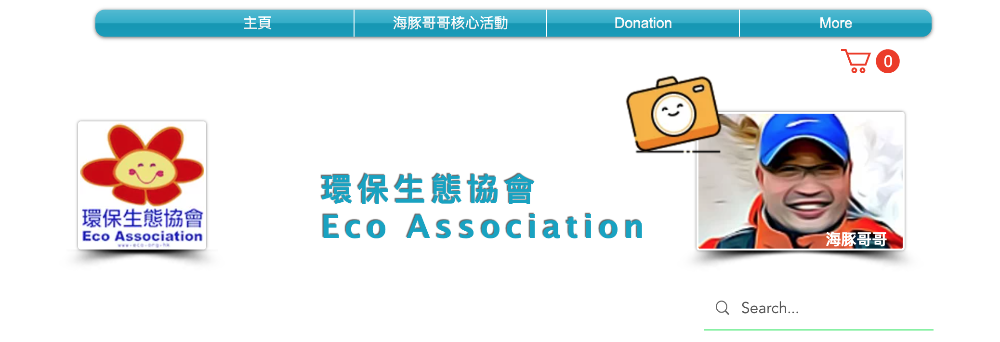
“義和豚！”
Campaign
Notes:
“豚起來!”

Slide 5
Aim
Keep long term supporter
To increase sustainability of the organisation

Slide 6
Objectives
To attract long-term donors , sustain the association support economically and sustain the relationship with them
To find volunteers, help with the operation in the association and increase their willingness to help
To find and attract people with knowledge, help the association in different research

Slide 7
Stakeholders
Government
Others organization
School
Donors

Slide 8
Content and messages
“義和豚！”
Emotional content
Content:
Joining ECO association and participating in ECO association, is a way to help the Marine ecosystem. Due to the epidemic, our association are facing a period of economic difficulties. We hope you support us to promote environmental education to protect the ocean and nature as well.
Messages:
Gather up Marine Lovers!
we need YOUR help.
「義和豚！」
Notes:
Tell we need long-term volunteer
Join our membership for exclusive benefits.
improving yourself and your career
ECO association has been operating ecological tours to see the dolphins. And we create a membership to get in touch with our target audience so that they can get the information of us instantly and join us and enjoy a day out with these beautiful pink dolphins.
ECO association have been educating and protecting the Marine life especially dolphins. To continue this protection, we need YOUR help.

Slide 9

Target audience
People who are interested in helping the dolphin and the association but have no extra time to help except donating money
People who are willing to help out the association through volunteering
People who are experienced in doing research on the marine ecosystem

Slide 10
Strategy
「義和豚！」計劃 Loyalty program
→ Types of loyalty members
Regular Donor 豚主
Regular Volunteer 豚員
Expert Volunteer 學術豚
Keep the long-term relationship with our target
Notes:
→ once they become our member
→ easy to reach/encourage them to join the activity by the having access to up-to-date, industry-specific resources and information

Slide 11
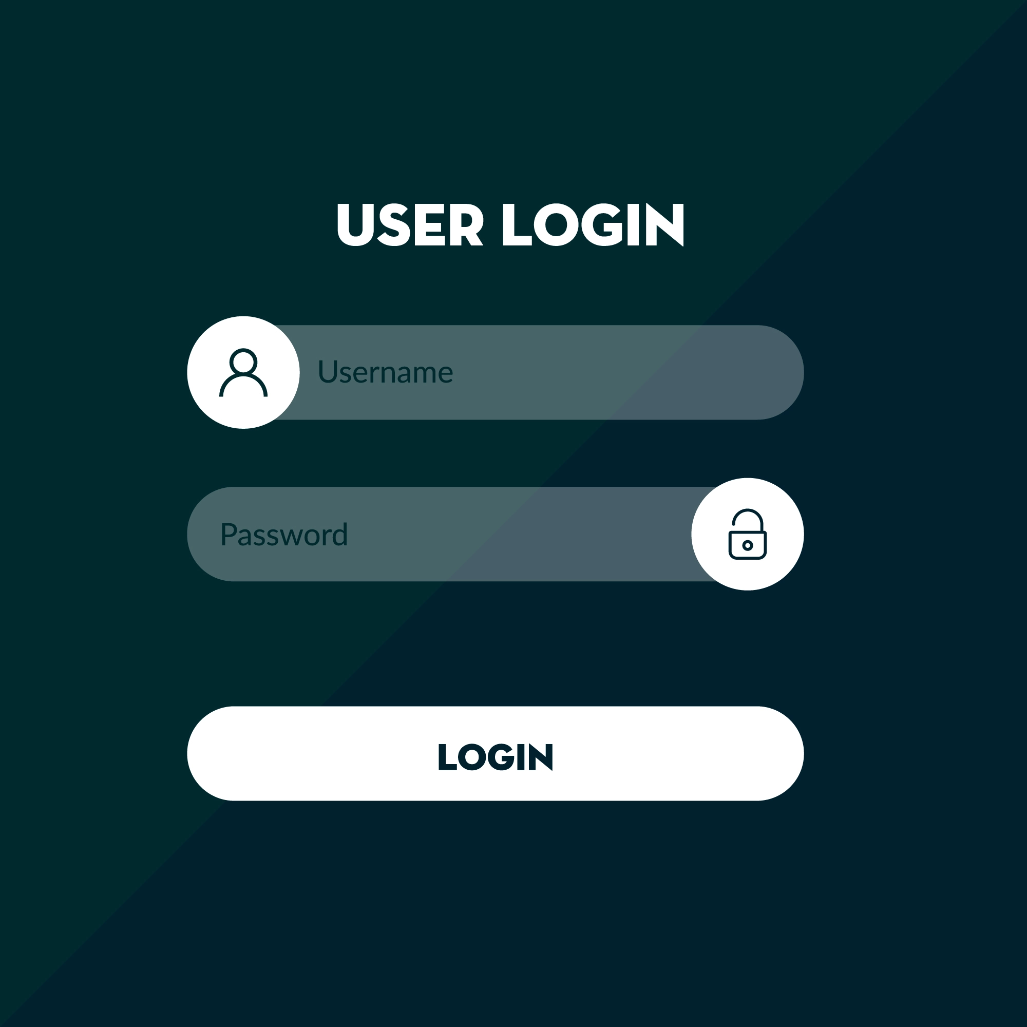
Log in System
They can check their status and redeem the gift via online
Record their volunteering hours
Donate money status
Do the redemption
Regular Donor 豚主
Regular Volunteer 豚友
Expert Volunteer 學術豚
「義和豚！」計劃

Slide 12
Tactics - Donor 豚主
Where can we find our regular Donor 豚主
Participants who have joined before
→ Send email and SMS to inform them we are going to launch a new campaign
Public who interested in helping the dolphin
→ Advertise our campaign in social media
Become our long term supporter to maintain the association
SO, how to encourage them to be our Donor 豚主 ?
Get some incentive to donate

Slide 13

Detail tactics
Donor 豚主 can choose a donation amount
Donation methods
Regular Monthly donation
  $200 monthly -Autopay
  Other amount
One-Cut donation
  $700/ $1400/ $2100
→ fill personal details to receive the incentive
Notes:
Call For Action:
Together, we can create a sustainable future for nature. Please support us!
→ engage the customers with personalized targeted promotions for instant communication (messaging, email)
→ improve their customer experience
→ Build Close Customer Relationship

Slide 14

Monthly Donation $200 Auto pay every month
3 months | 6 months | 9 months | 12 months | Other Amount
Souvenirs | Souvenirs $50 voucher 10%off discount | Souvenirs $50 voucher 10% off discount $50 voucher x2 15% off discount | Souvenirs $50 voucher 10% off discount $50 voucher x2 15% off discount Souvenirs Free tour | Amount above 250 can receive the same incentives.
**** All incentives will be sent to their email
= received in previous month
=receive in this month
Donor will receive a souvenir on the first month when they started their donation.
Also they can receive incentives in consecutive 3/6/9/12 months.
→ Encourage them to keep donate money

Slide 15

One-off Donation
$700
$1400
$2100
Souvenirs
Souvenirs
$50 Voucher x2
10% off discount of the activities
Souvenirs
15% off discount of the activities
Free tour

Slide 16
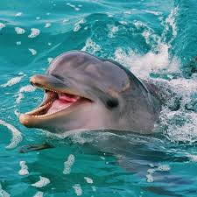

Once, the become our Donor 豚主..We WILL..
Send a personalized email to them
  thank you email to all donors
    A personal salutation, using the donor’s preferred name.
    link to a page about upcoming events or volunteer opportunities.
    a sincere thank you for the donor’s contribution.
  Get exclusive email updates on the project’s progress

Slide 17


An additional monthly email to donors to keep them engaged
  talks about the benefit of signing up for recurring donations:
    “Your monthly gift guarantees…... . A monthly donation of any amount is an easy way to……...”
A printable certificate recognizing each member by name and acknowledging their support of the association
→ Build Close Customer Relationship
→ People share their donations and support, others will be inspired to donate themselves

Slide 18

Tactics - Regular Volunteer 豚員
For volunteering work
  Help out planning activity and paperwork
  Assist on supervising and participate outdoor activity
  E.g. low income family
Volunteer hours ~ Donor’s package
  Providing tours
  Discount
  Souvenirs etc..
***Meals provided in outdoor activities

Slide 19
Detail tactics
Volunteering hours integral system 時數積分機制
  Indoor activities
  Outdoor activities
Rewards (example)
  20 hours → Souvenir
  30 hours → Souvenir
  35 hours → Self published book
  40 hours → Single course
  80 hours → Dolphin’s Tour
  125 hours → Full Course (Depend)
***Integral would recount each year.
(豚友名稱)
豚員記錄
24/3
5hrs
2/6
16hrs

Slide 20

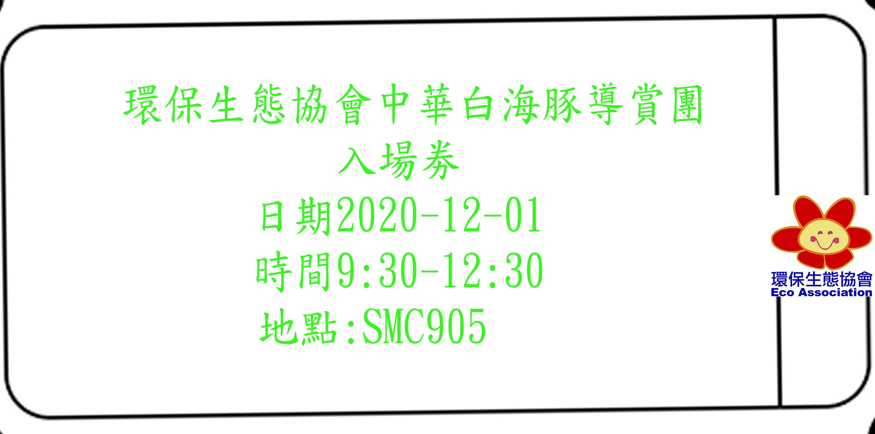




Souvenir example template
CUP
Silicone rubber bottle
Pen
Recycle Bag
Tour Ticket
Ticket

Slide 21

Tactics -
Tactics - Expert Volunteer 學術豚
For corporate association
  University committee
  Or other company
Provide training programme
With internship
  Provide more knowledge and experience to the volunteer in the internship
  Volunteers can become more specialized after the internship
  More expert volunteer can be produced in the future
Have a communication with foreign expert who come to Hong Kong travel
  Seminar and workshop could held to interact with foreign expert when they come to Hong Kong
  Some activities can invite the foreign expert
  Even current expert volunteer can have more knowledge through the communication

Slide 22

Detail tactics
Provide internship opportunity,At least 160 Hours
For those participate to prepare for their career
Exchange the training course to improve knowledge
Internship salary are paid by having
training programme

Slide 23

Re-union for Loyal members
Gather up members
Increase the members’ sense of belongings in the association
Encourage members’ to exchange ideas
Make interaction between all type loyal members
Thanks for their help

Slide 24
Detail Tactics
Through registration with registration fee
First come first serve
Quota: 60 members + Workers

Slide 25
Media Channel
How can we attract our target audience to join the campaign
Existing Media channel
→ Website
→ Facebook (Organic Reach, e.g. share post)
→ Direct communication (messaging, email)
Place our campaign information
Reach the specific target

Slide 26
Timescale
 | Month 1 | Month 2 | Month 3 | Month 4 | Month 5 | Month 6
Task | -Souvenir template design -Design the login system | -Finding supplier of the souvenir -Design the login system | -Quotation the souvenir -Design the login system | -Promotion i.e. social media post, finding intern in the school and some organization | -Promotion i.e. social media post, finding intern in the school and some organization | -Launch the Campaign -Promotion i.e. social media post, finding intern in the school and some organization

Slide 27
Budget (short-term)
Amount of souvenir - first month(trial) : 300 amount
Pen x 100 - $250
File x 100 -$400
Sticker x100-$50
Promotion fee -
Poster (own designed) x 50
Leaflet (own designed) x 200-300
A4 Paper $40
-ink fee x $700
Total: below $2500

Slide 28
Evaluation
How many donor can we attract?
How many volunteer can we attract?
Can we achieve objectives?
Did the supporter recommend it to their friend?
Whether sufficient money have been raised?
How much research has been conducted by expert volunteer

Slide 29
Keep long term supporter
To increase sustainability of the organisation

Slide 30
References
世界自然基金會香港分會. (2020, 11 29). 世界自然基金會香港分會 | WWF Hong Kong. Retrieved from 世界自然基金會香港分會 : https://www.wwf.org.hk/
環保生態協會. (2020, 11 29). 主頁 | 環保生態協會. Retrieved from 環保生態協會: https://www.eco.orgSix Months Procurement Roadmap | PowerPoint Slide Templates Download | PPT Background Template | Presentation Slides Images. (2020, 11 29). Retrieved from https://www.slideteam.net/six-months-procurement-roadmap.html: https://www.slideteam.net/six-months-procurement-roadmap.html.hk/

